Slide 1

Suburban Dreams: The Rise of the Rental Market
Industry Project Group 40
Ingrid Freeman Phoebe Fan Clarissa Hew
Ngoc Duy Tran Yasa Tjoe

Slide 2




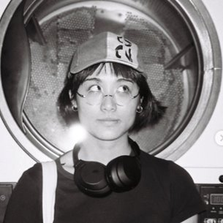
Our Team
INGRID
DUY
PHOEBE
YASA
CLARISSA
Loves a swim, playing footy, and making music with her friends
If intelligence is a weapon, I’m unarmed
Loves to play violin and tennis, and enjoys having a swim
Would talk about anything with anyone. Lives to eat (and drink), sleep is non-negotiable
Loves cooking and sewing
Notes:
(Clarissa)
(30 sec) – introduce what each person is saying

Slide 3
Forecasting the rental market in Victoria
INTRODUCING THE PROBLEM:
Ever-increasing cost of living in Australia
Slowing economic growth
Rising interest rates
→ Increasing rental population
KEY QUESTIONS:
Q1: Most important internal and external features in predicting rental prices?
Q2: Top 10 suburbs with highest predicted growth rate?
Q3: Most liveable and affordable suburbs?
Notes:
(50 sec)

Slide 4





PROJECT LOGISTICS
PROGRAMS & APPLICATIONS USED
Python
GitHub
COMMUNICATION
2 stand-ups per week:
1 weekly in-person
1 weekly zoom
Regular updates via Teams and Messenger
TIMELINE
Duration: 6 weeks (thus far)
Sprint 1
Sprint 2
Sprint 3
Sprint 4
Sprint 5
Sprint 6
Sprint 7
Data Acquisition
Preprocessing
Analysis & Visualisation
Machine Learning
Deliverables
Notes:
(20 sec)
ADD ESTIMATED HOURS OF WORK PER CHECKPOINT (mostly on preprocessing + scraping)

Slide 5

ACQUISITION OF DATA

Slide 6
ACQUISITION OF DATA
RENTAL DATA
Sources: Scraped from domain.com.au
Size: ~ 1,000,000 rows
Time range: 2017 – 2023
Internal Features
Features relating to properties (eg. No. of rooms, no. of bathrooms, etc.)
INFRASTRUCTURE DATA
Sources: Scraped and collected from many different sources
External Features
Schools
Hospitals
Public transport stops (bus, tram, train)
Open space (parks, forests, etc.)
Distance to CBD (from each property)
CENSUS DATA
Sources: Collected from ABS
External Features
Population by postcode
Median Income by postcode
Crime rate by postcode
Notes:
(Clarissa)
(30 sec)

Slide 7

DATA PIPELINE
Notes:
(Yasa)

Slide 8
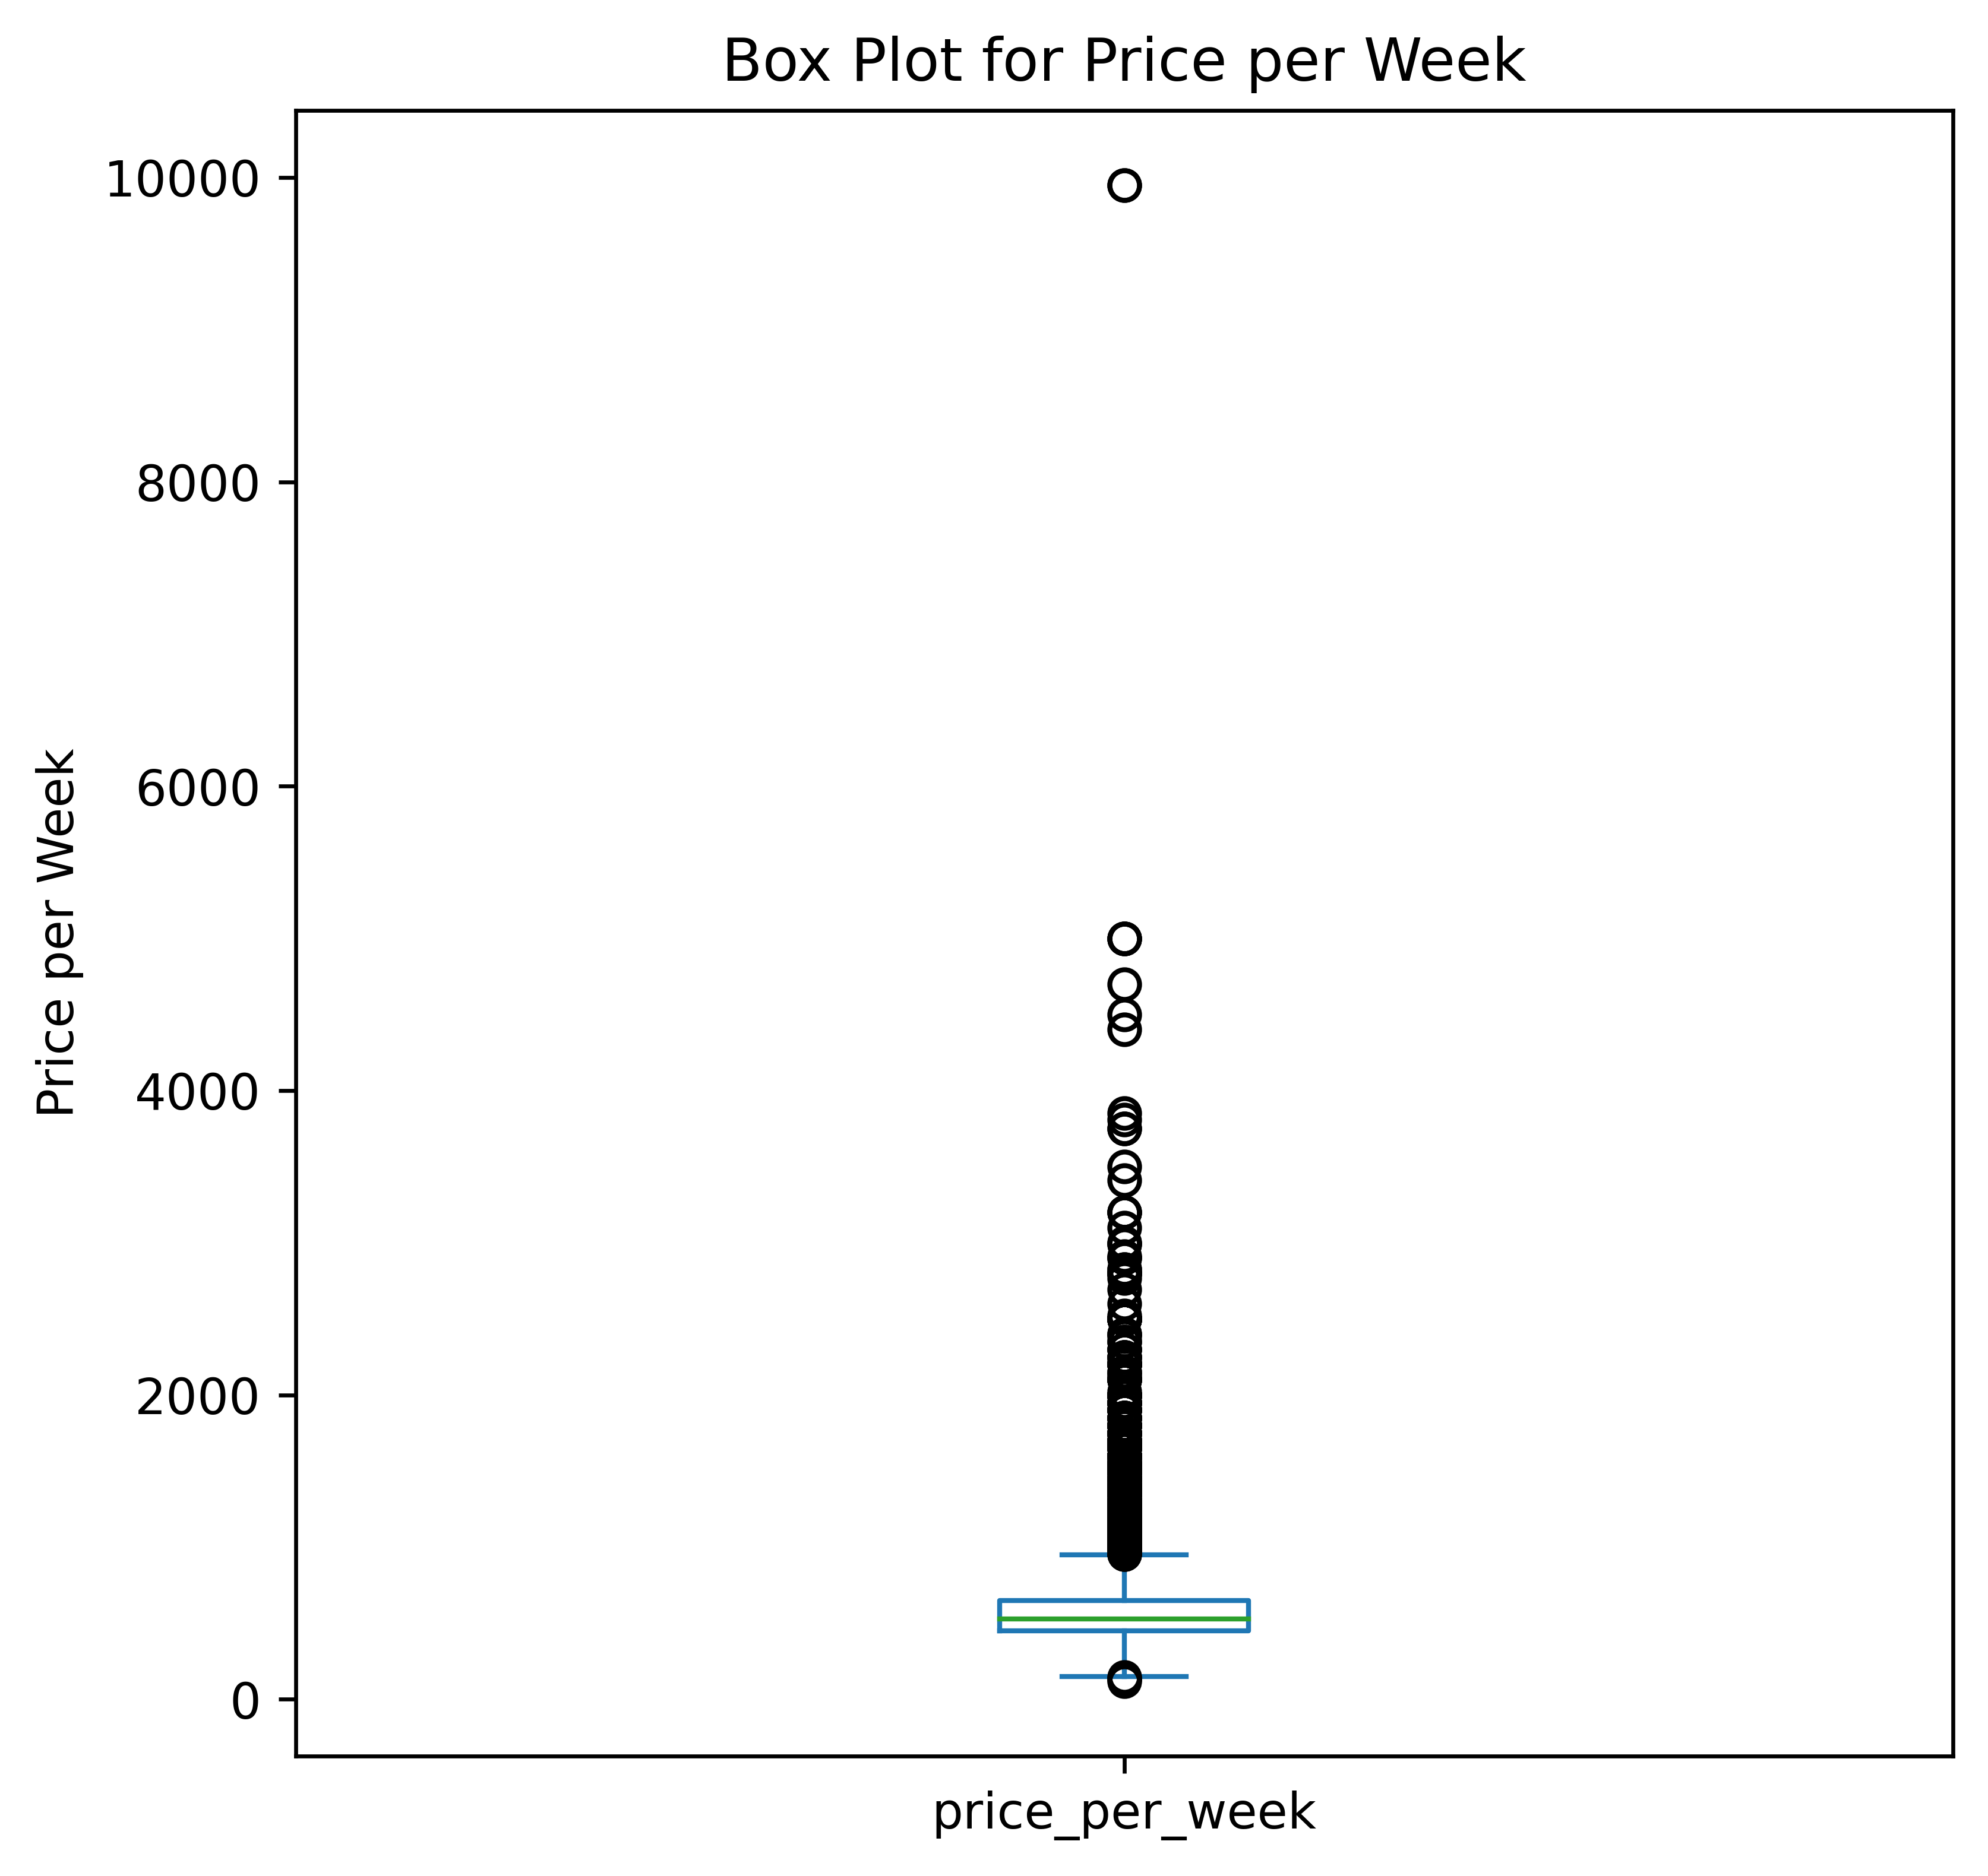
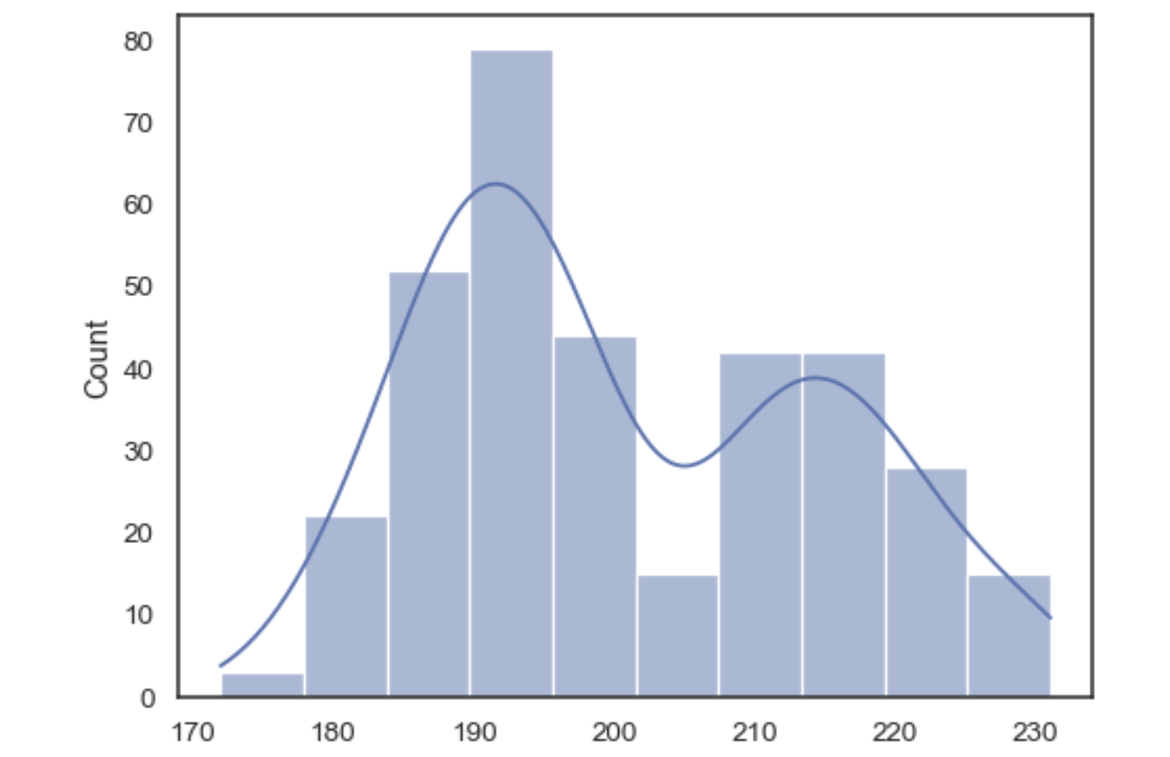
Data pipeline
Train with Lasso Regression and Light Gradient Boosting Methods
COLLECTION
Scraped and collected
OUTLIER DETECTION
IQR range
Web verification
DATA PARTITIONING
Train – test set
Information leak
Privacy requirement
Reasonable imputation
MODEL TRAINING
DATA IMPUTATION
Notes:
(20 sec)

Slide 9
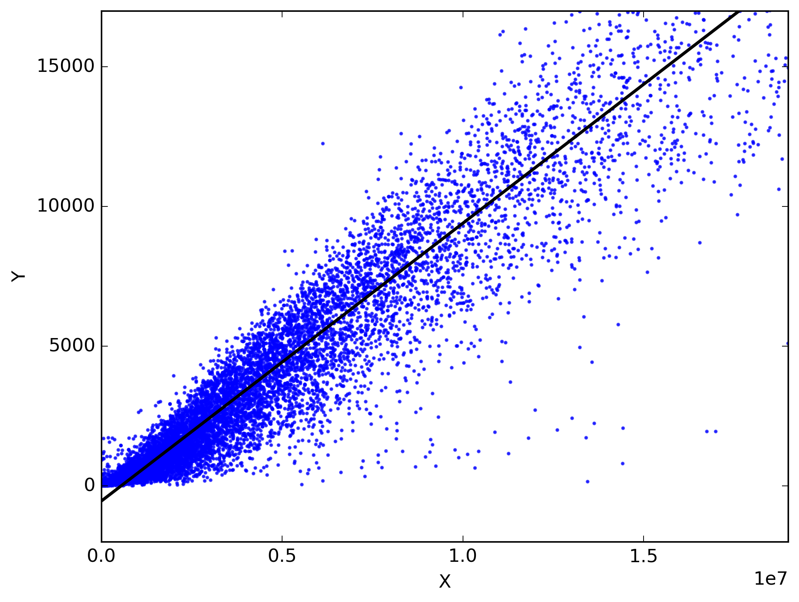
MODELLING
 | Lasso | LGBM
MAE | 138.59 | 92.68
MSE | 91262.35 | 52919.78
MAPE | 0.2305 | 0.1466
Notes:
ADD DEFINITION OF MODEL ETC.
(20 sec)

Slide 10
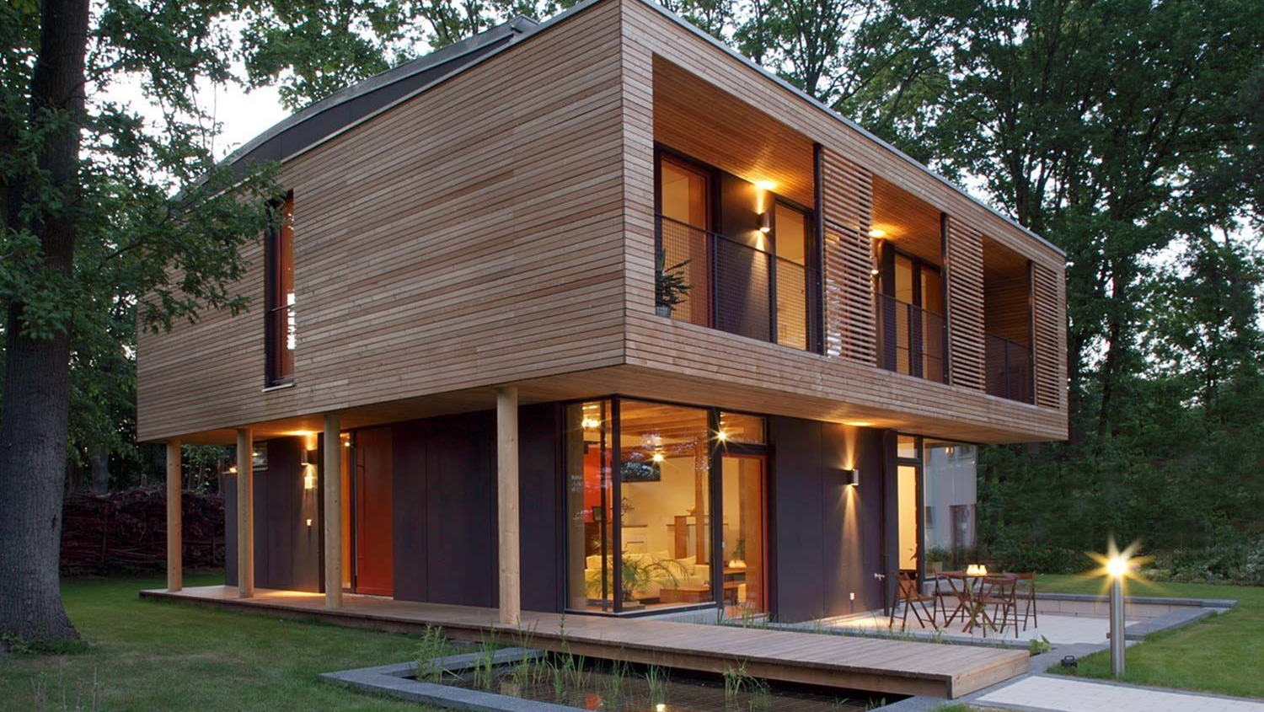
Determining factors of rental price

Slide 11
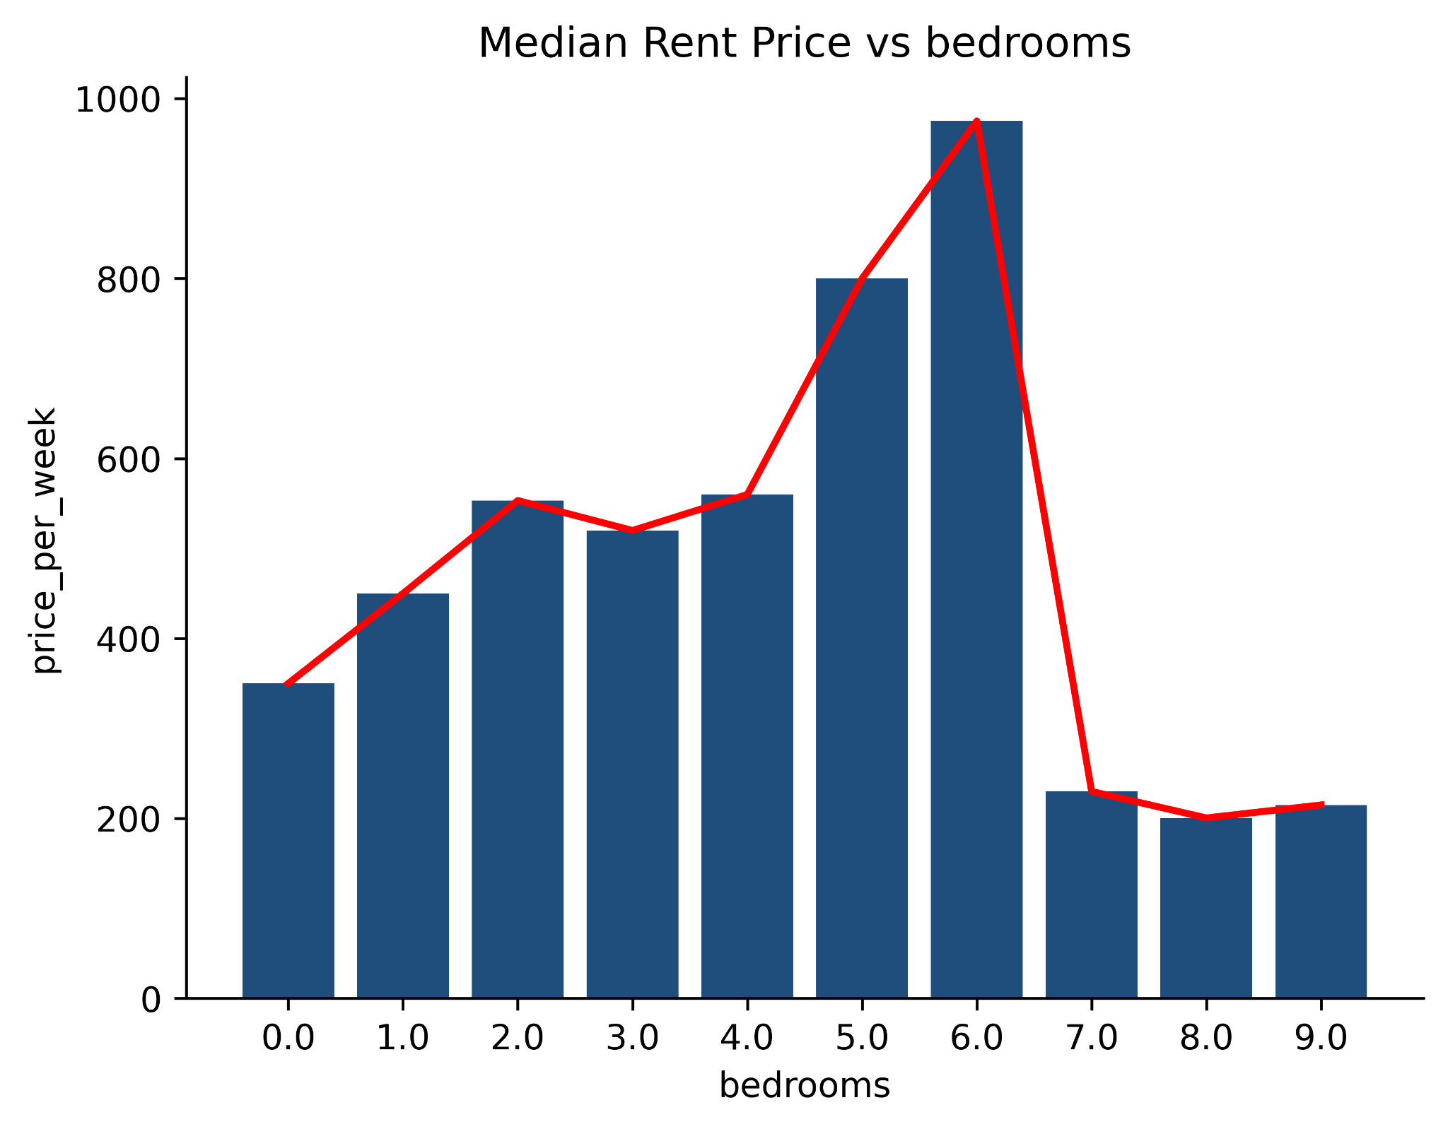
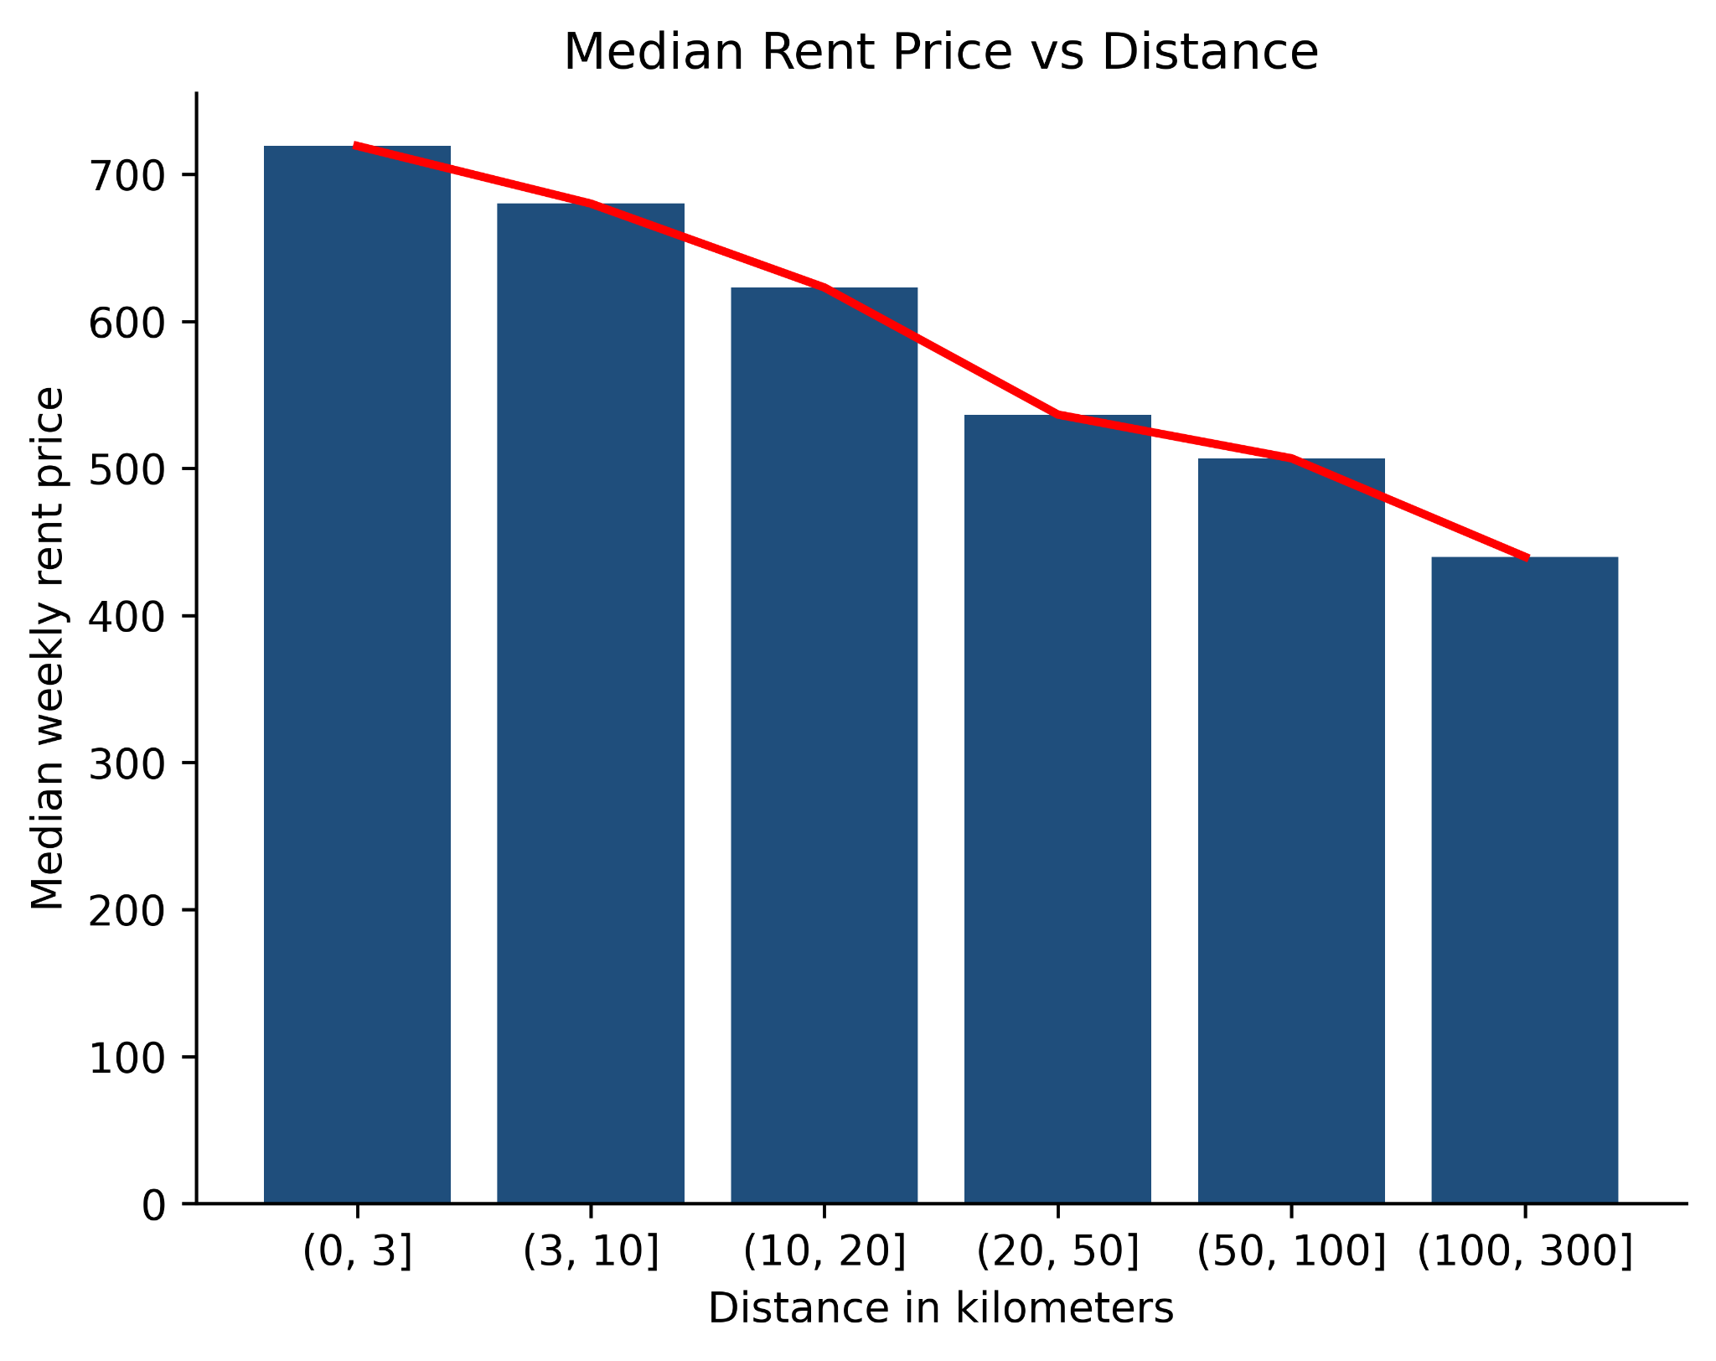

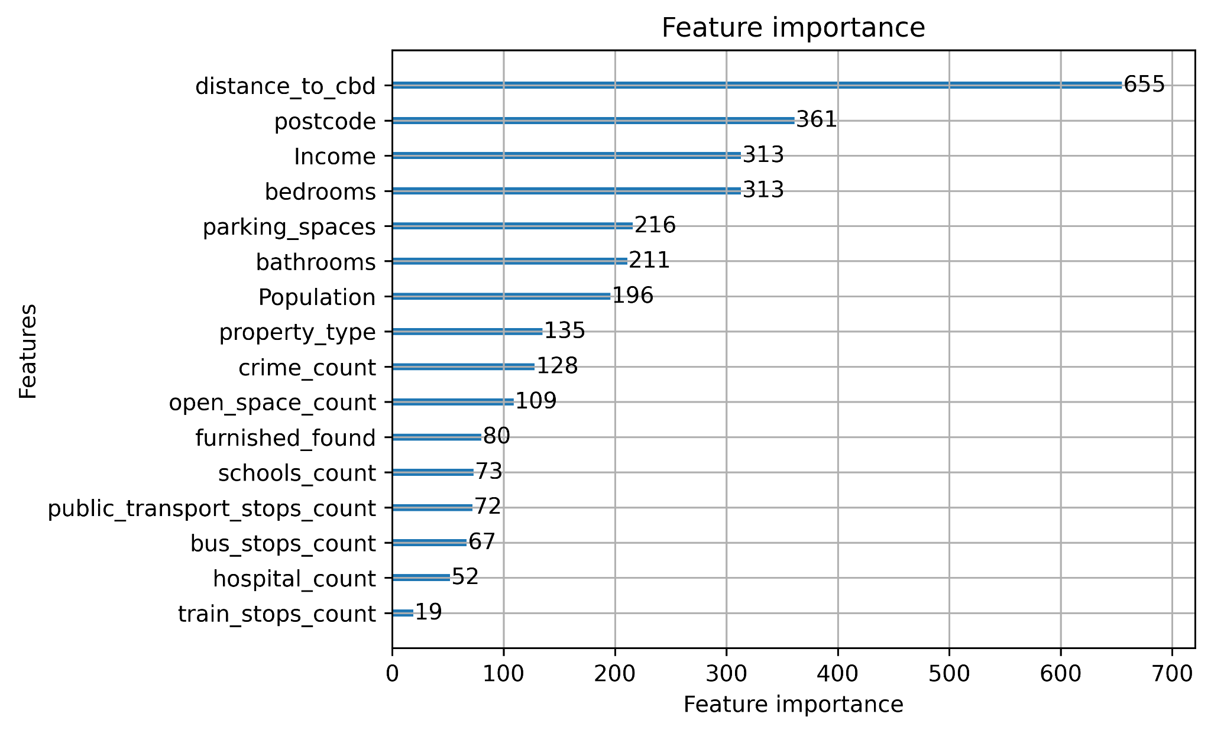
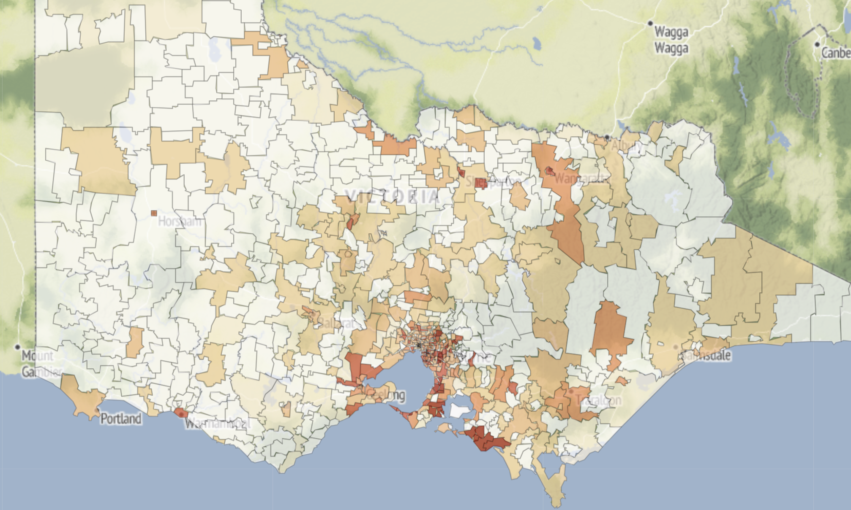



FEATURE PRIORITY
Distance to CBD
Far away from CBD ~ less expensive rent
Postcode
Some are much higher, and lower
Income
Affordability
Bedrooms
Bedrooms
More bedrooms ~ more area
More bedrooms ~ more area
Notes:
(Yasa)
(1 min)

Slide 12
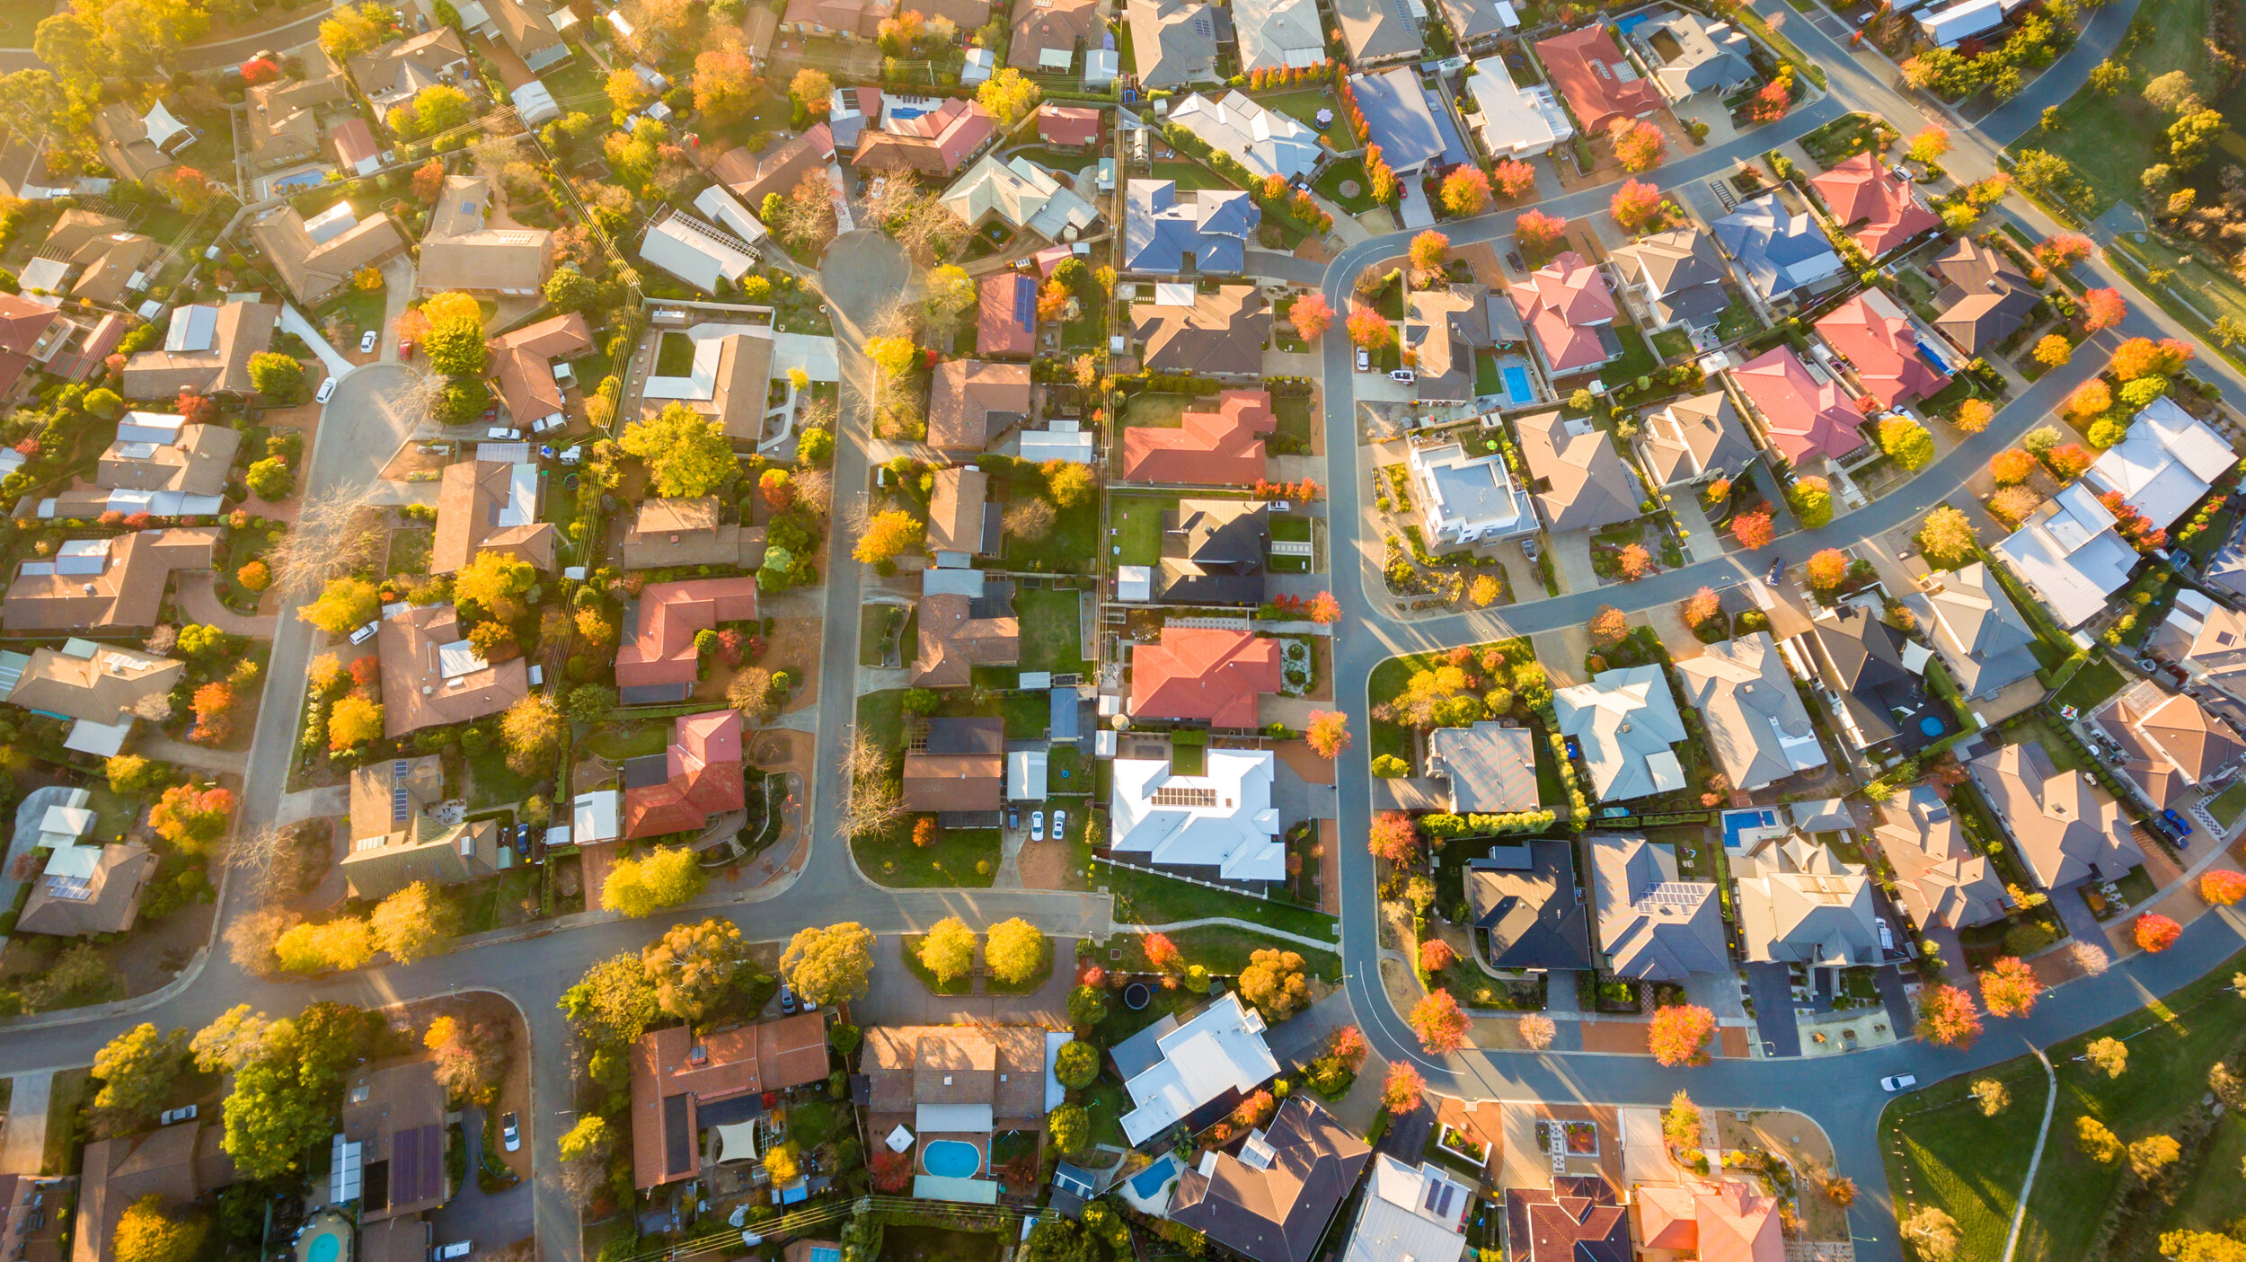
Suburbs rising in price
Notes:
(Ngoc)

Slide 13
PROPERTY GROWTH
STATISTICS
Assumption: Previous years’ data is highly useful for forecasting future growth
MACHINE LEARNING
Assumption: Forecasted income and population by postcode are reasonably correct
Postcode | Population_2023 | Income_2023
3000 | 48623 | 1299
3132 | 17215 | 2120
3163 | 34144 | 2002
3844 | 31828 | 1608
3465 | 10038 | 943
Table: Population and income by postcode
Notes:
(30 sec)

Slide 14
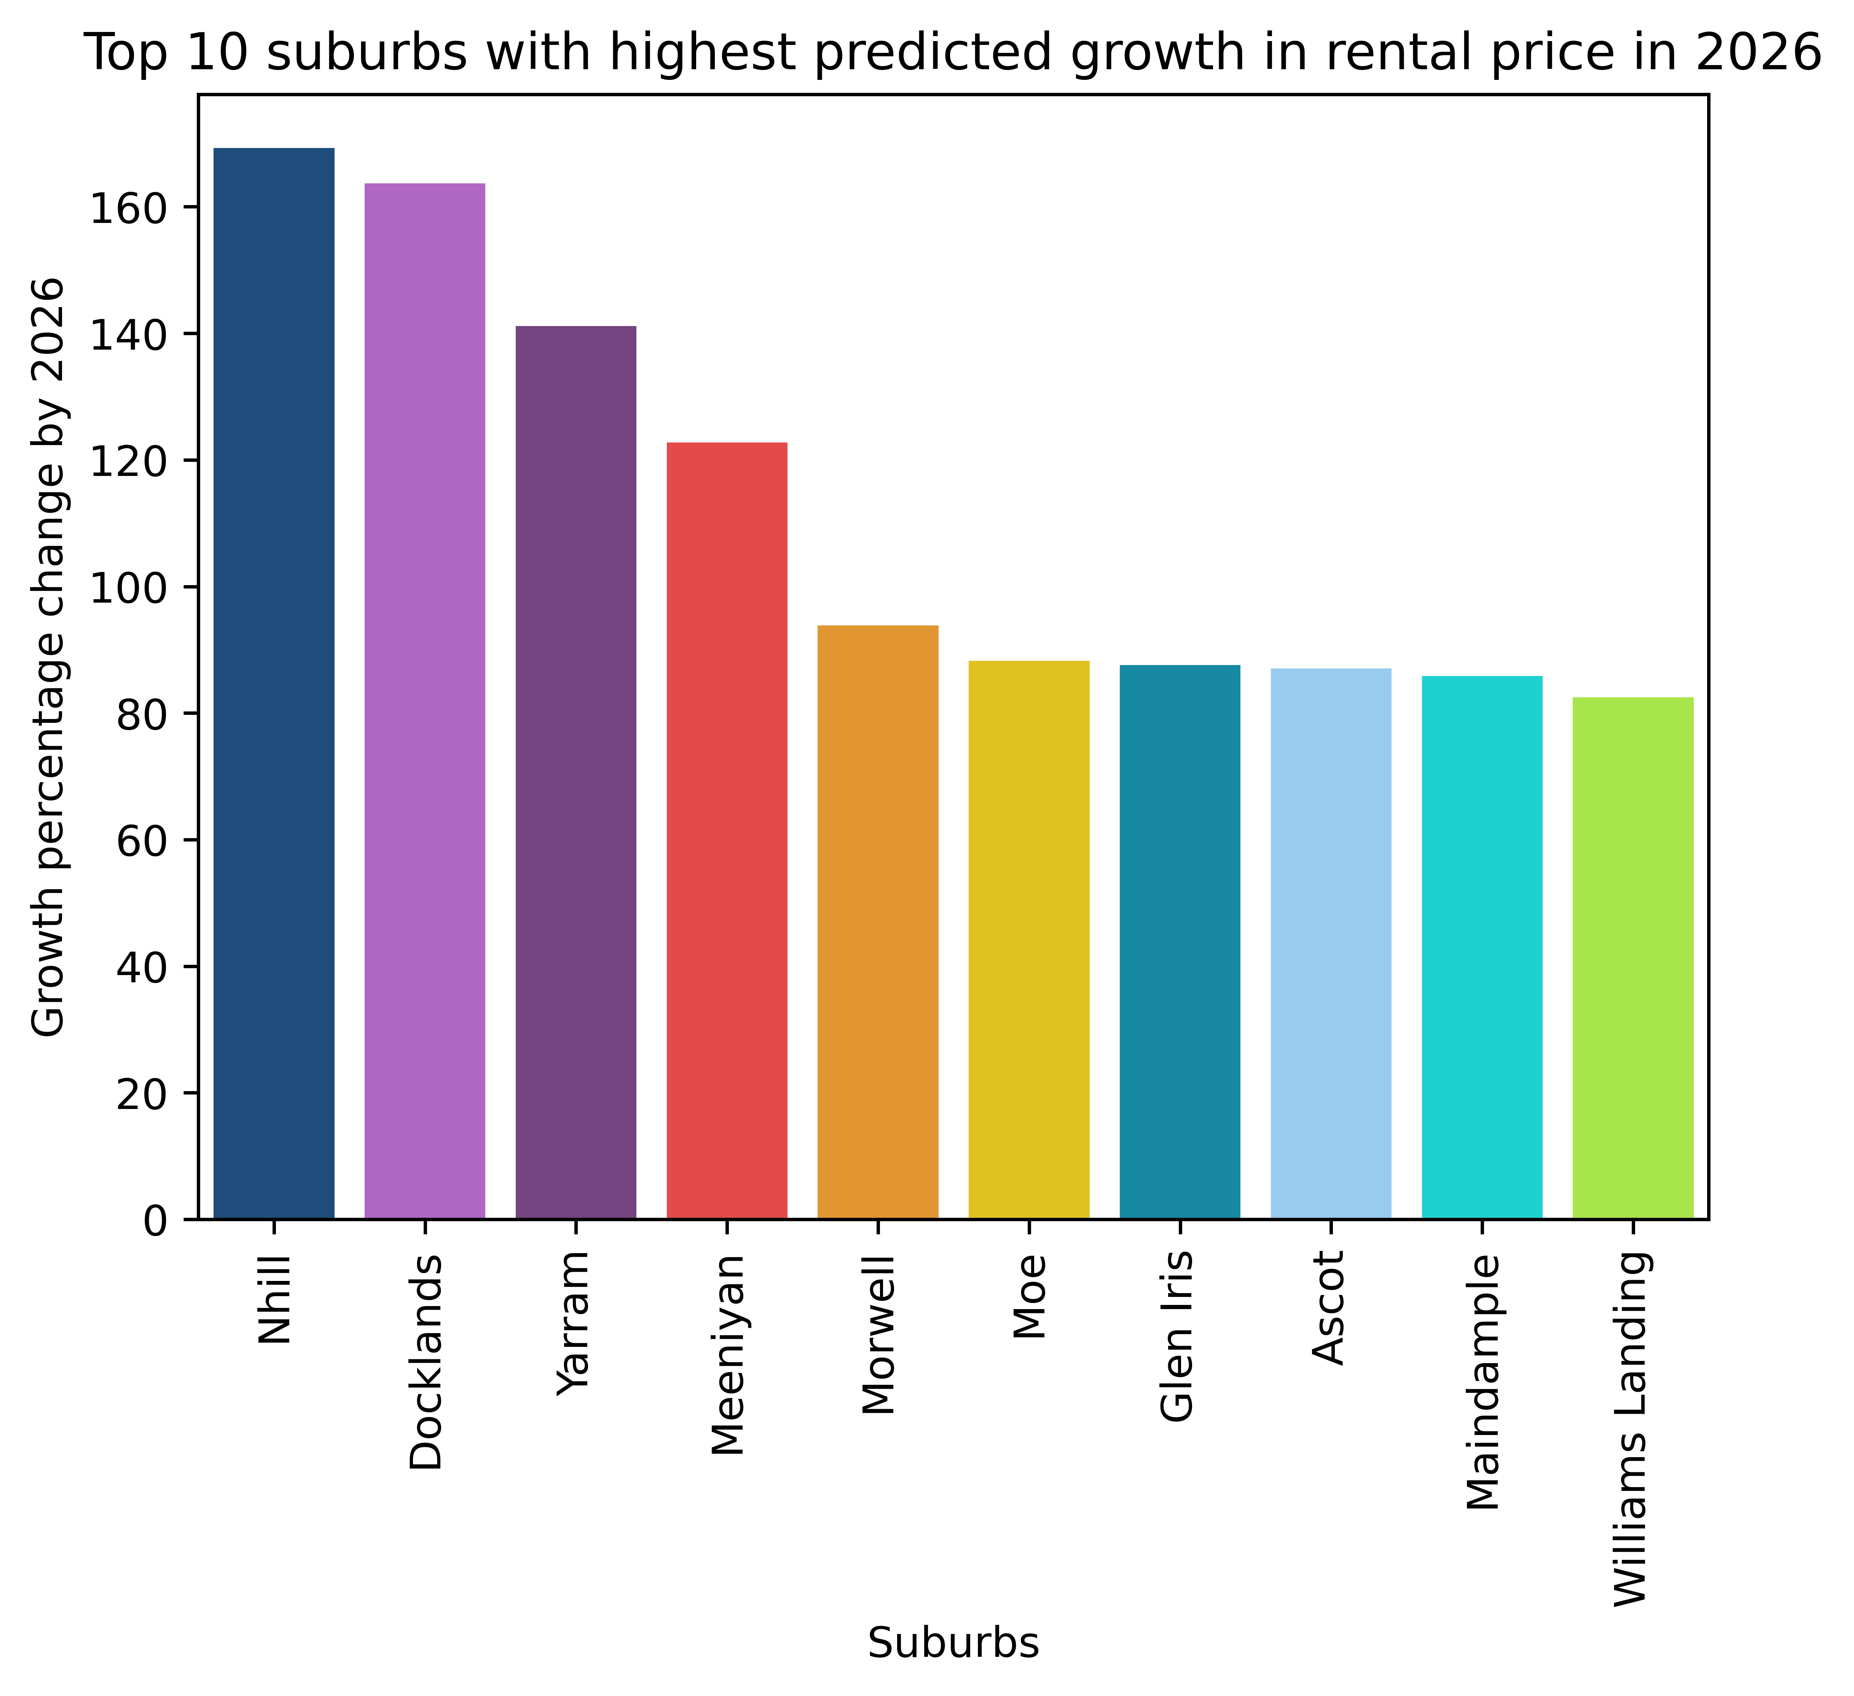
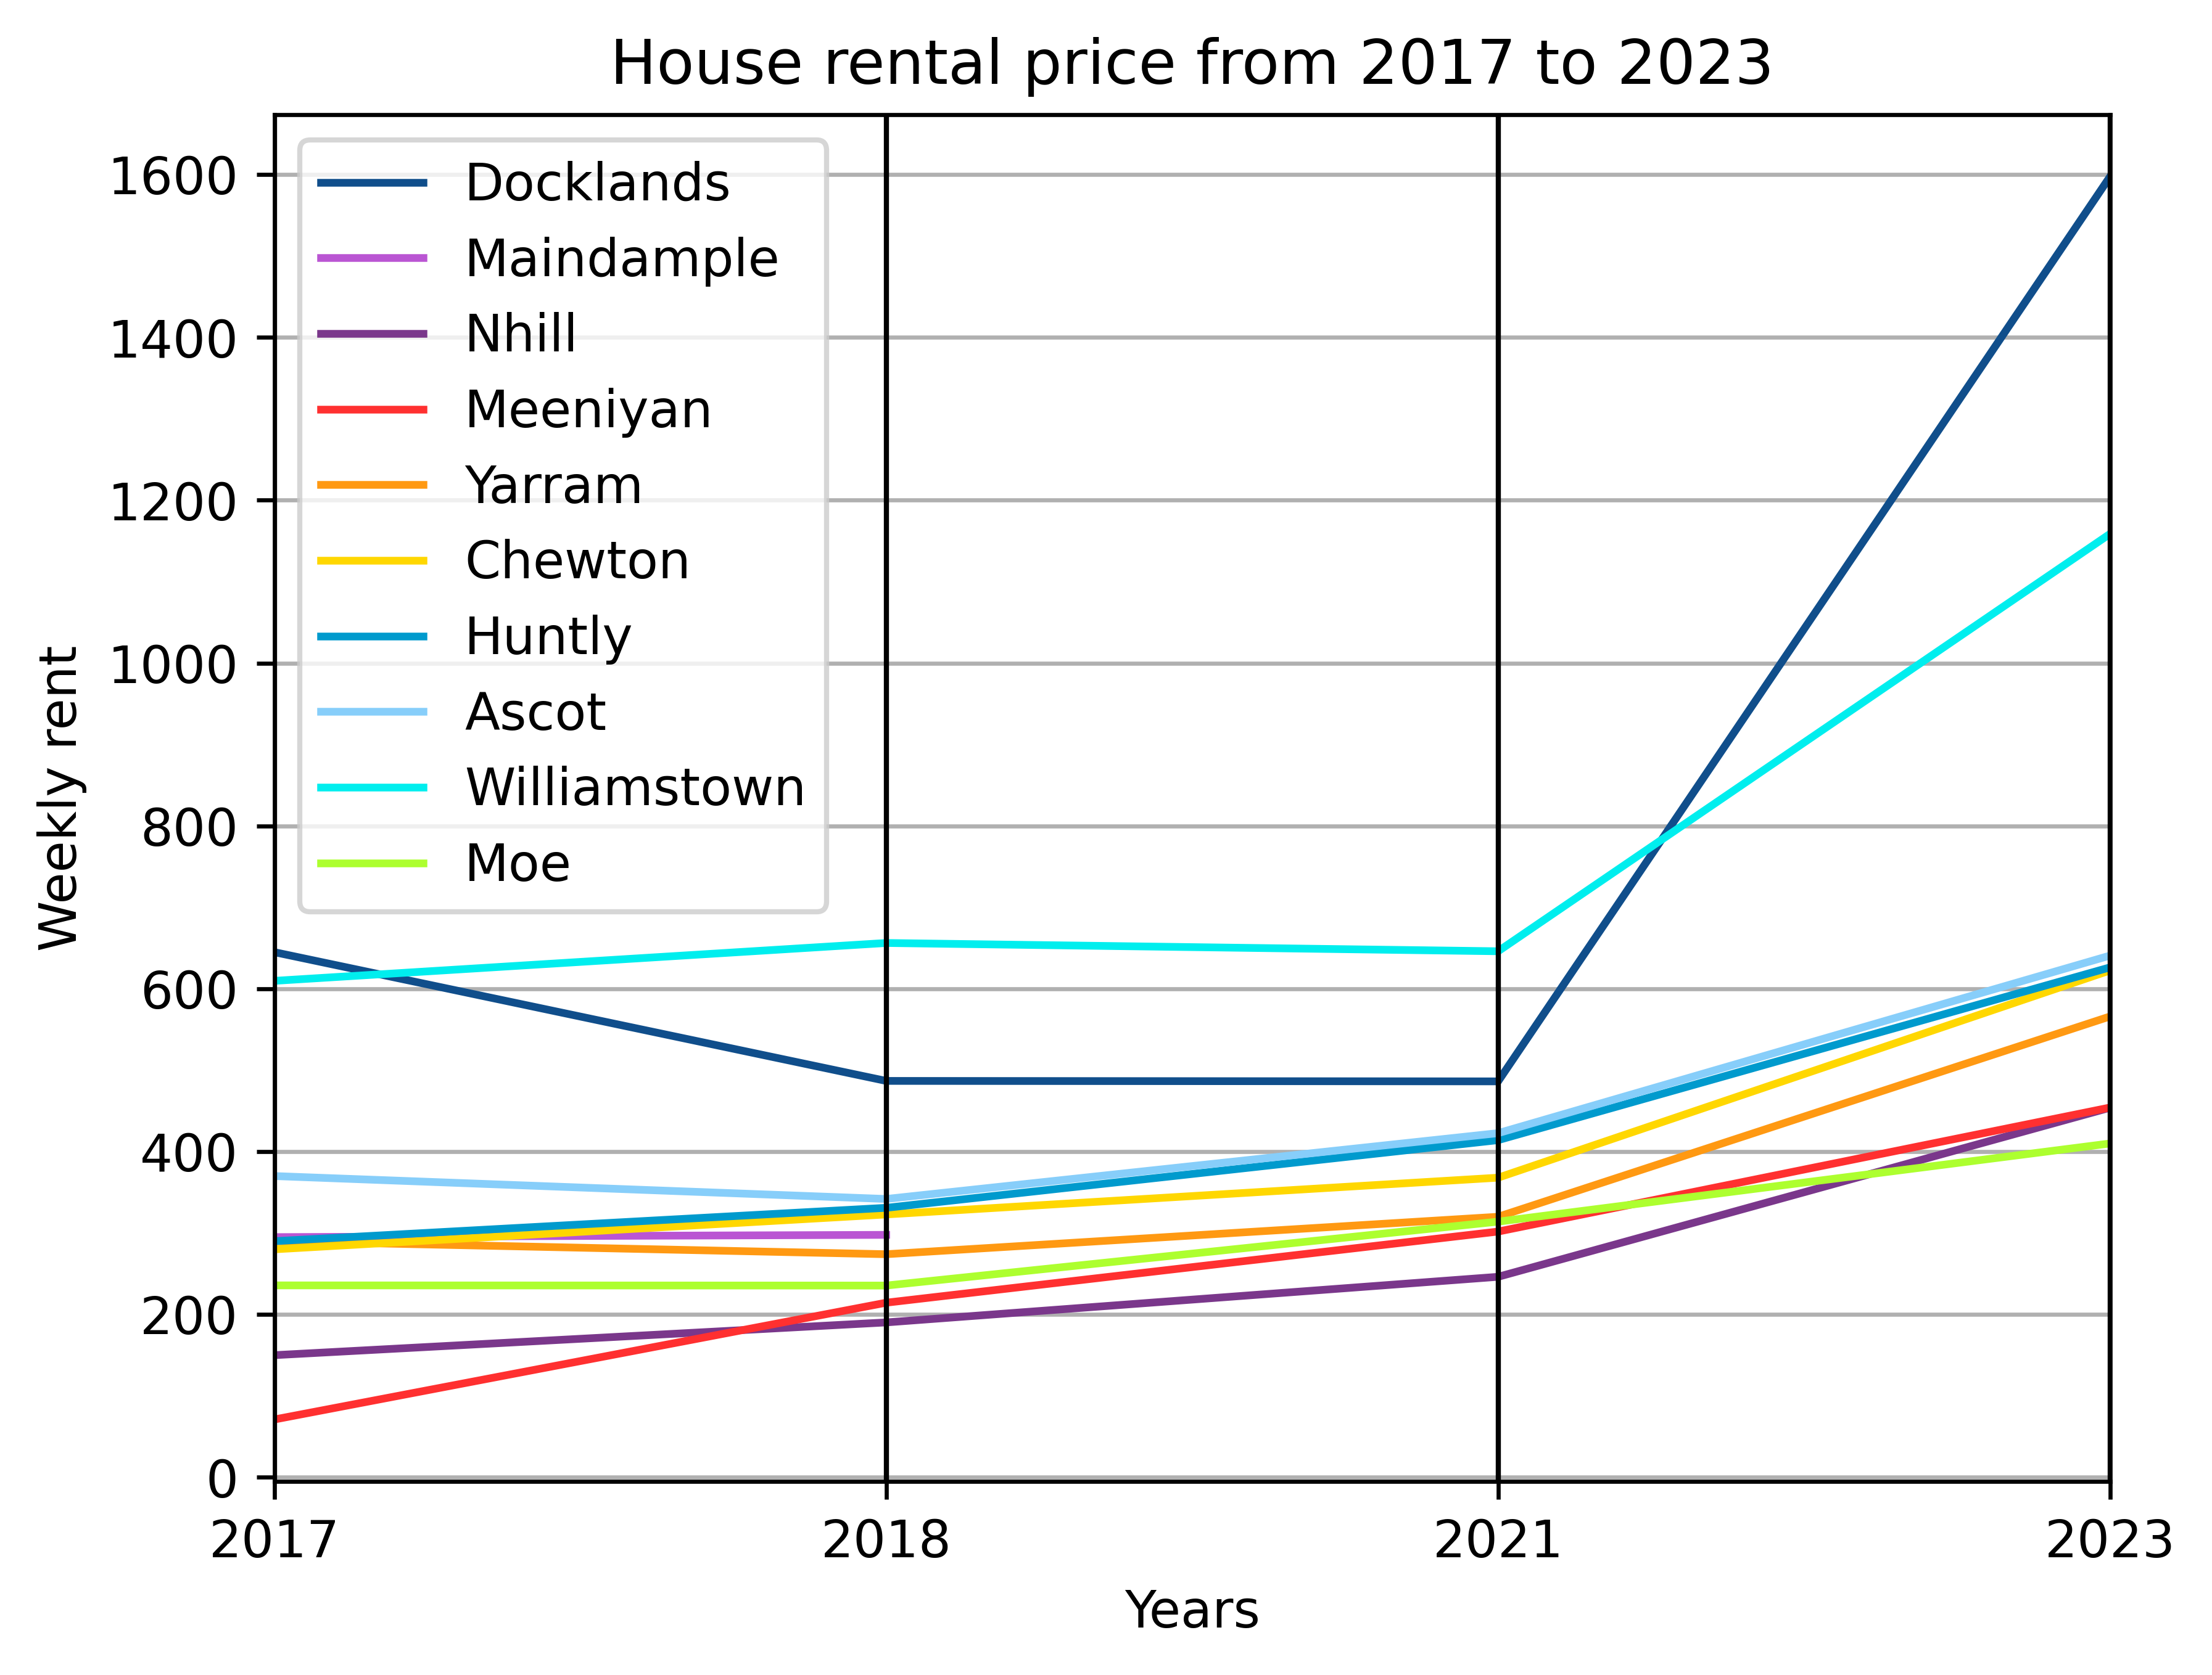

HOUSE GROWTH
STATISTICS
Assumption: Previous years’ data is highly useful for forecasting future growth
STATISTICS
Overlapping Suburbs: Docklands, Nhill, Meeniyan, Yarram, Ascot, Maindample, Moe
Notes:
(20 sec)

Slide 15
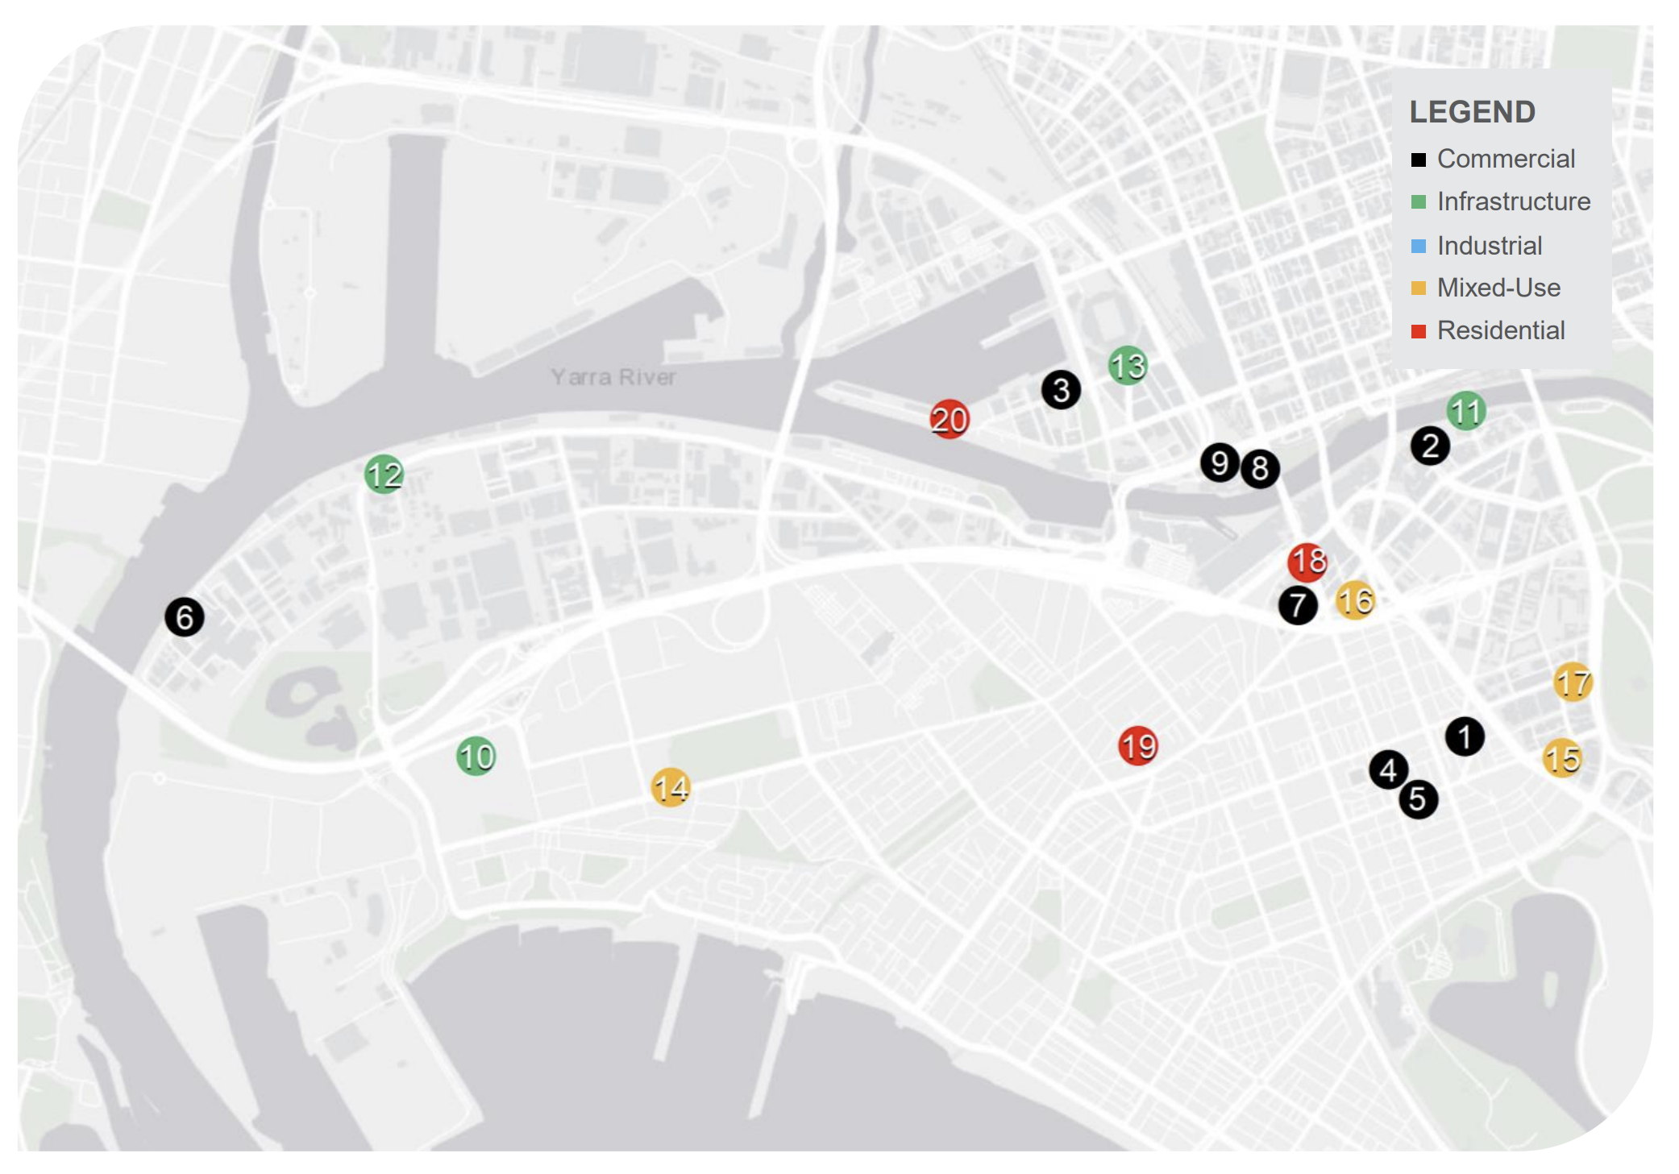
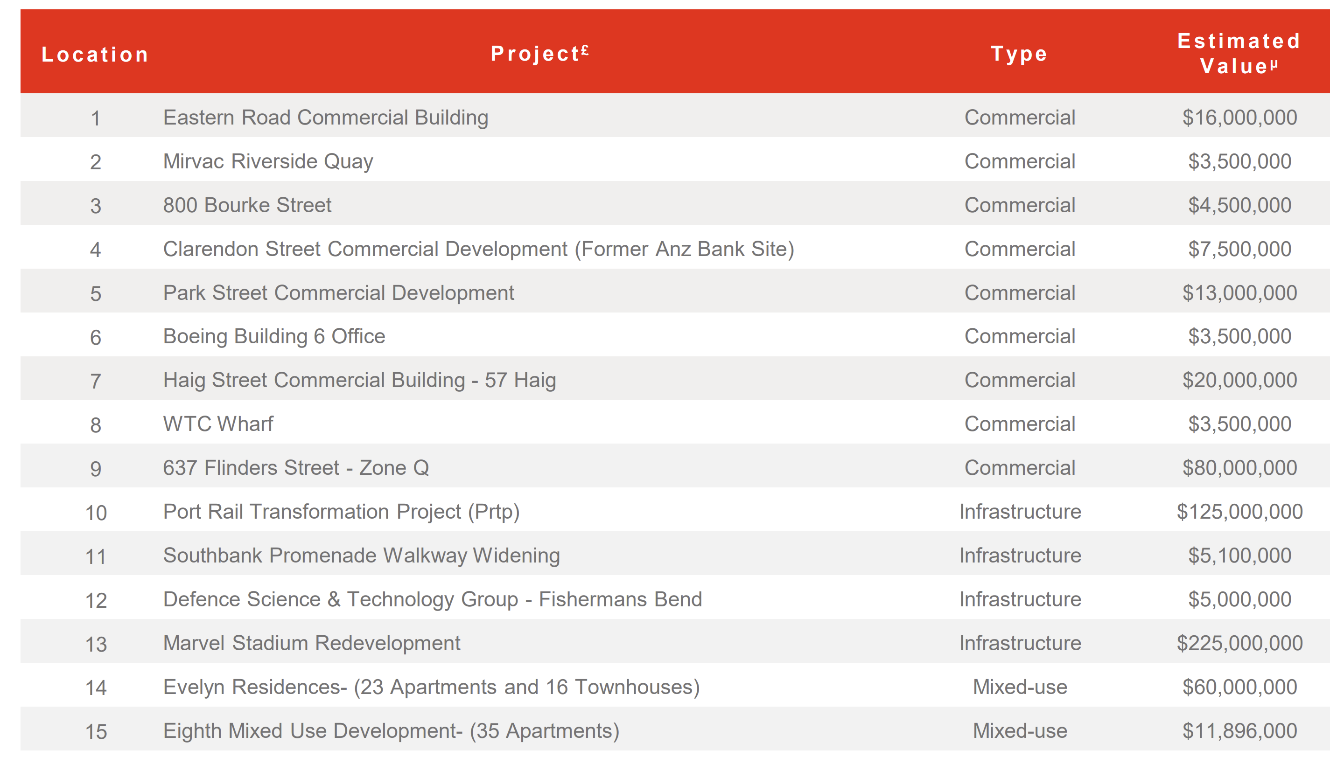
JUSTIFICATION FOR DOCKLANDS
BASED ON INTUITION:
Effective Urban Planning
Migration
BASED ON ML:
Population
Income
Notes:
(30 sec)

Slide 16
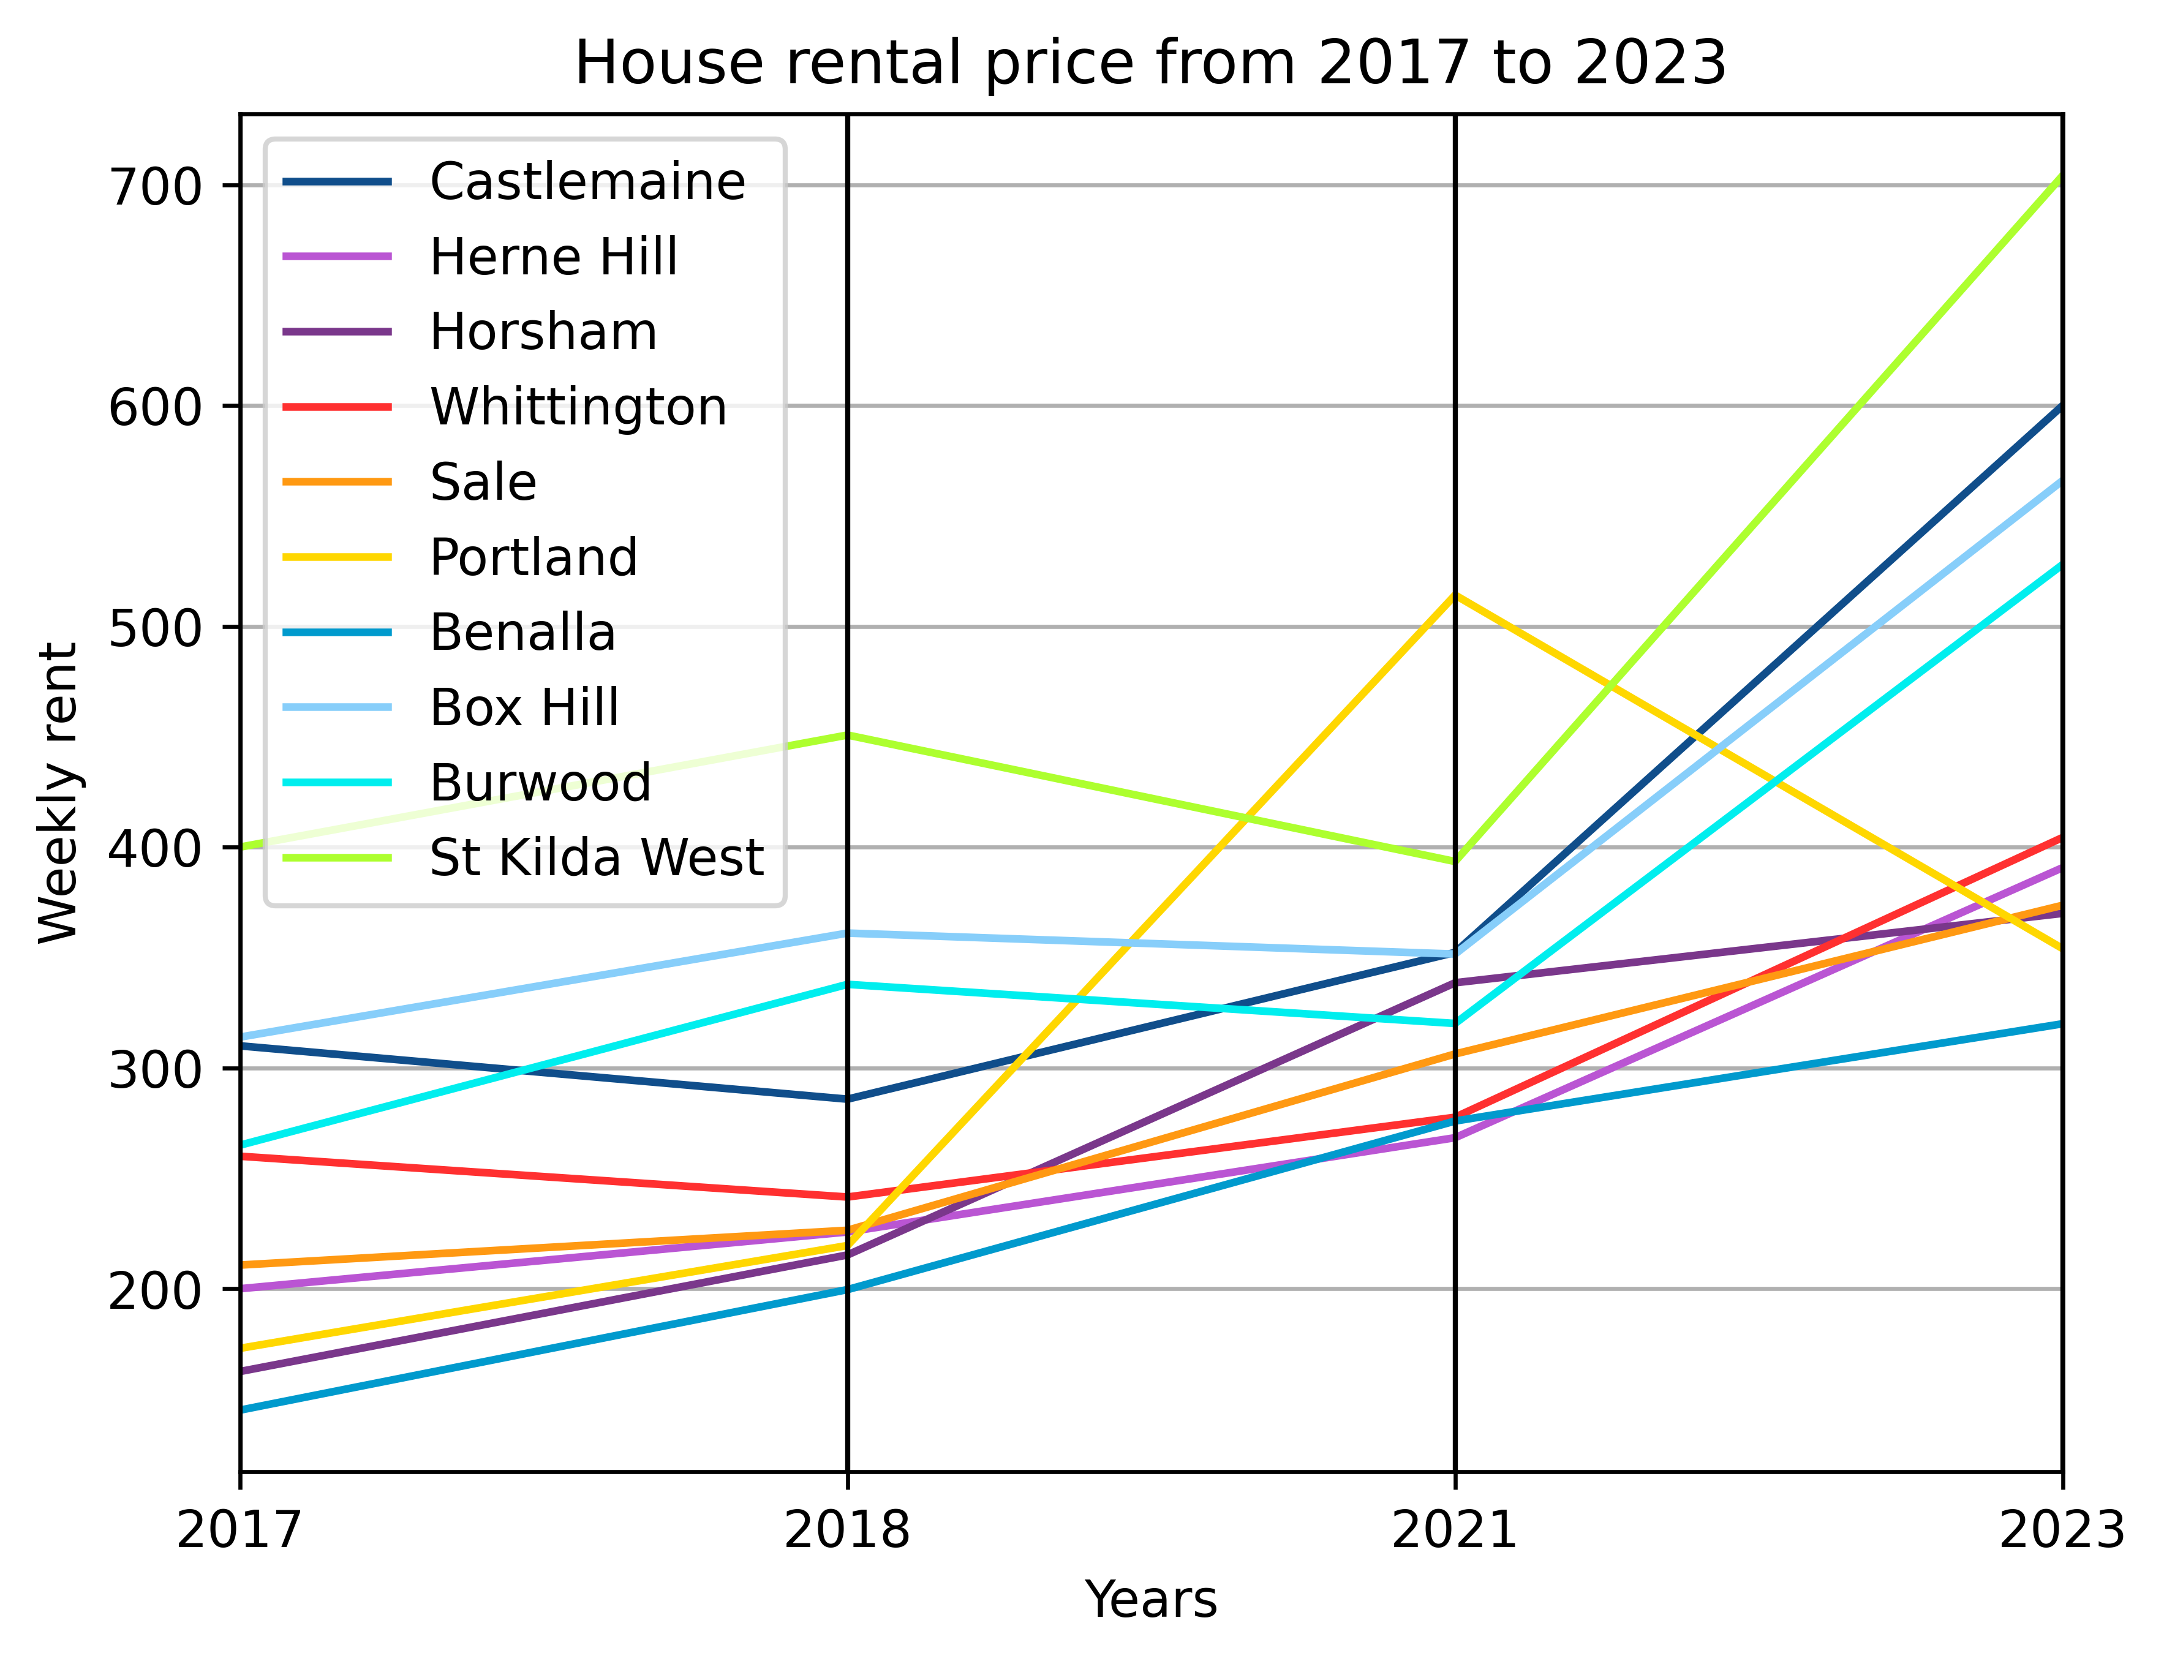
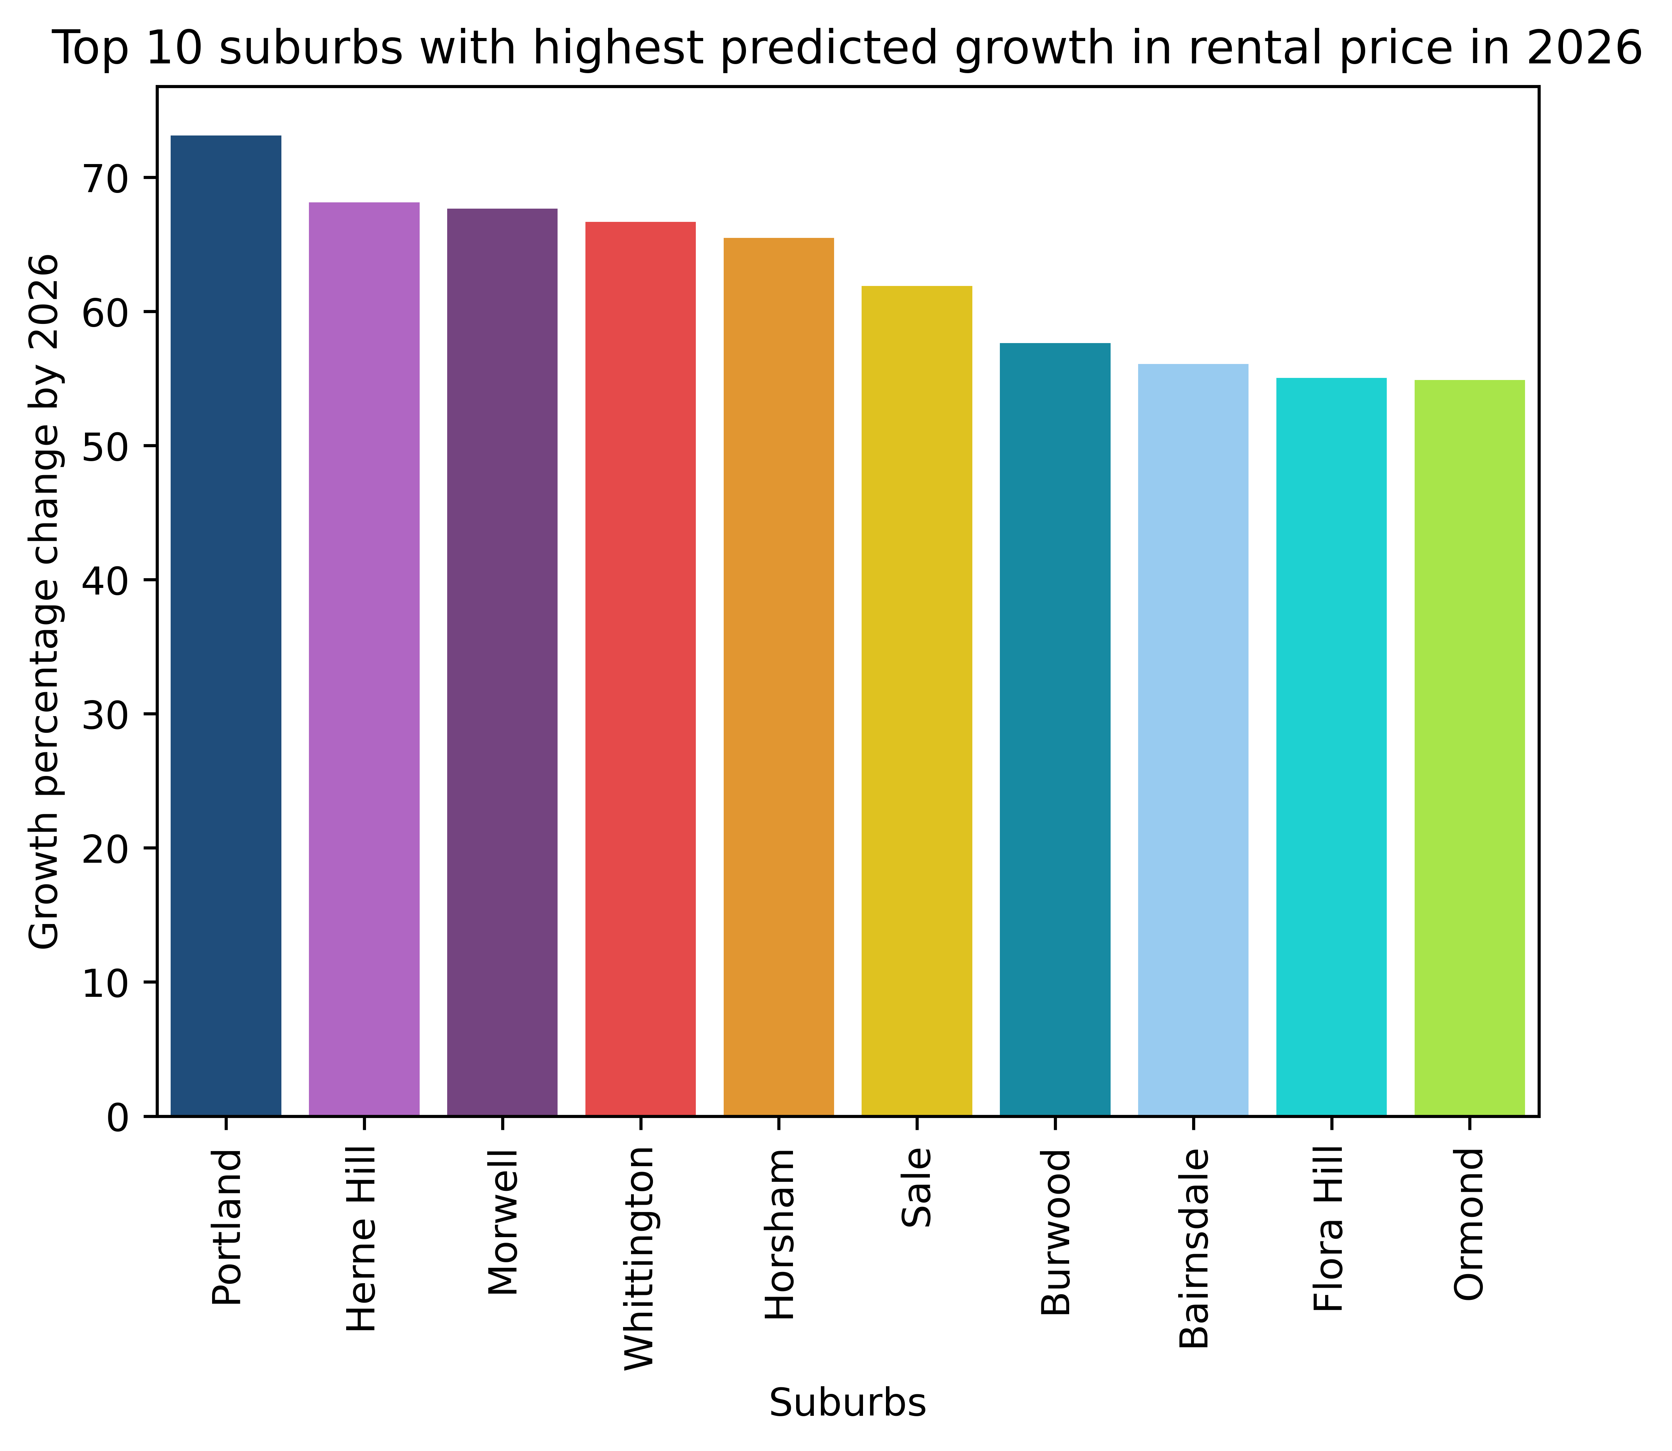
APARTMENT GROWTH
STATISTICS
Assumption: Previous years data is highly useful for forecasting future growth
STATISTICS
Overlapping Suburbs: Portland, Heme Hill, Burwood, Sale
Notes:
(15 sec)

Slide 17
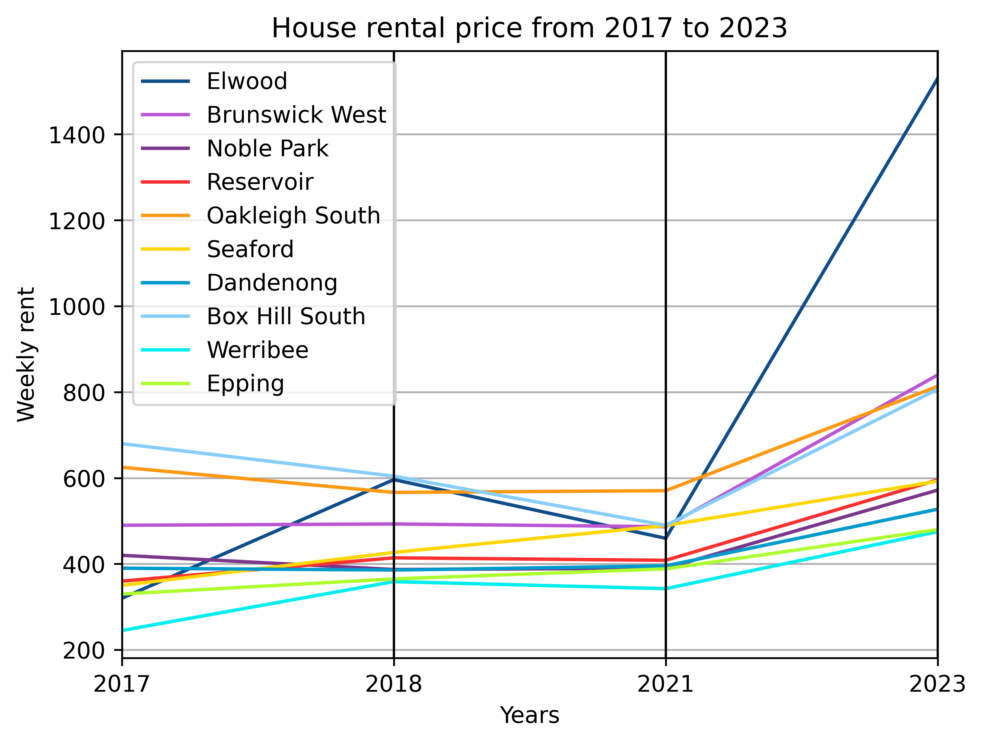
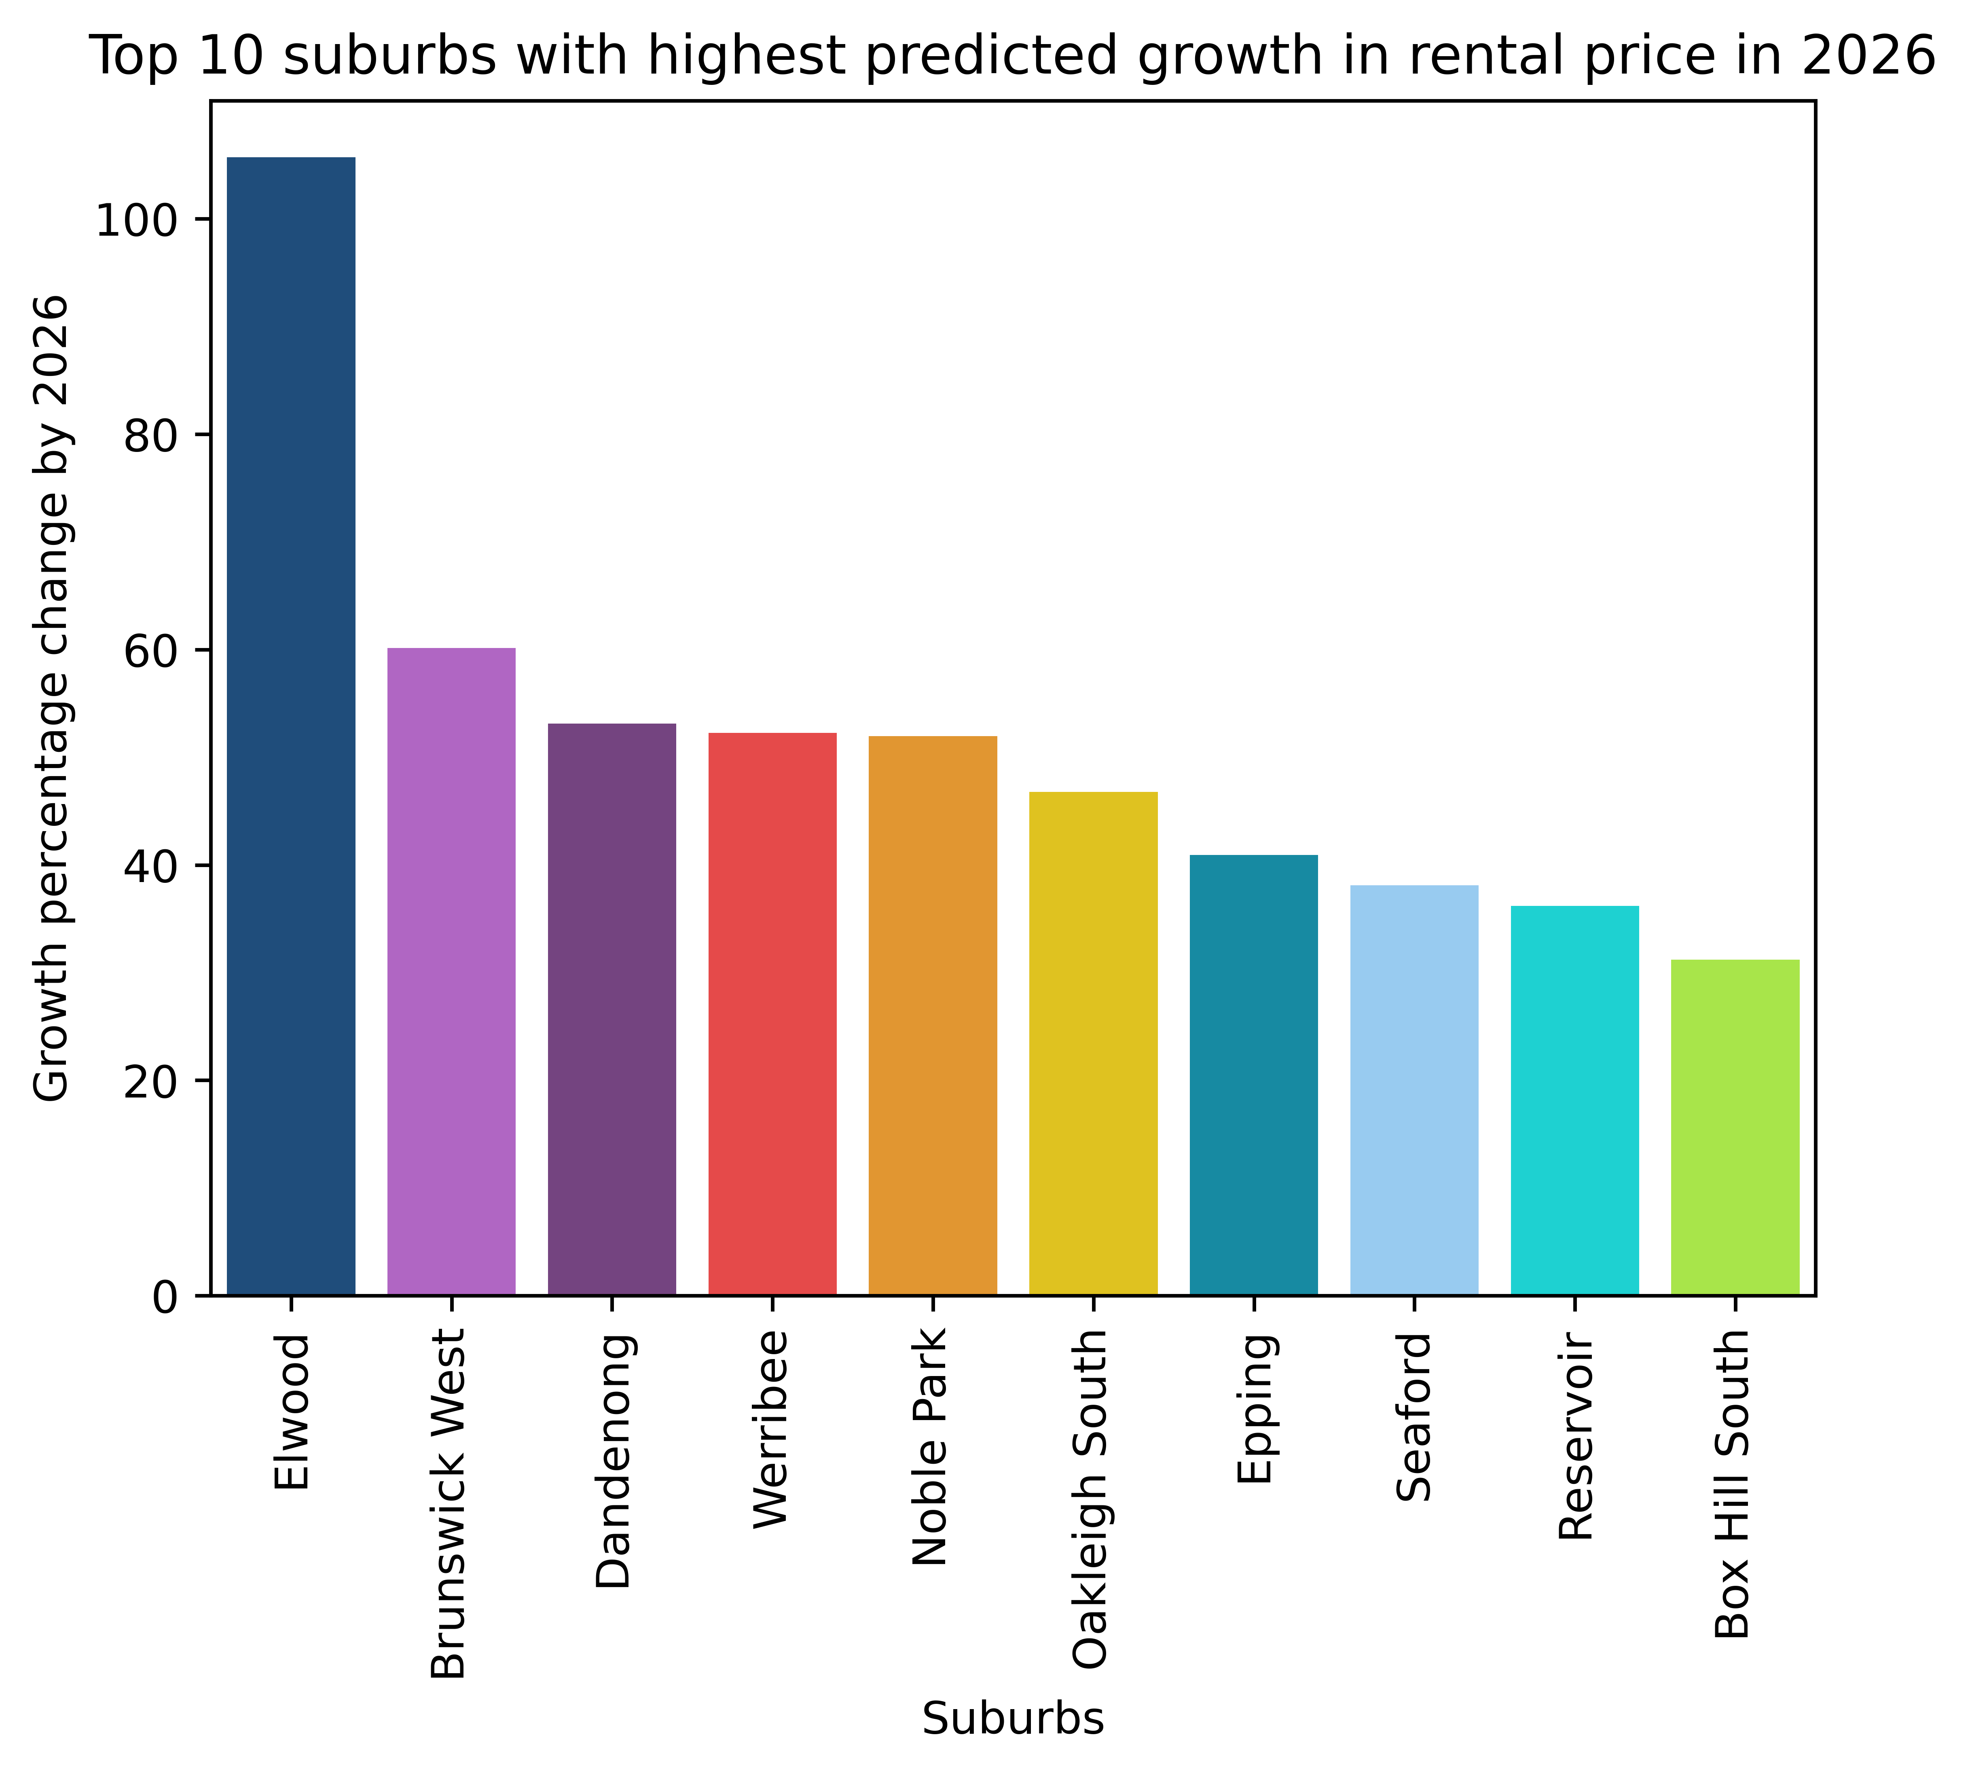
TOWNHOUSE GROWTH
STATISTICS
Assumption: Previous years data is highly useful for forecasting future growth
STATISTICS
Suggested: Elwood, Dandenong, Oakleigh South
Notes:
(Ngoc)
(10 sec)

Slide 18

Most Liveable & Affordable suburbs
Notes:
(Ingrid)
(2 mins)

Slide 19




LIVEABILITY
DEFINING LIVEABILITY
All our liveability factors are linked to the United Nations Sustainable Development Goals:
Access to healthcare and hospitals
Access to schools, childcares, and universities
Access to open and green space
Connectivity through public transport
Absence of crime
Notes:
We drew upon the method of liveability calculated by the Australian Urban Observatory.
This takes stock of all relevant United Nations Sustainable Development Goals which contribute to the everyday lives of residents, so all of our liveability factors are also linked to these. Each of these features was then standardised and given a weighting. For example the number of train stops has a higher weighting than the number of bus stops, given trains provide faster travel connections in to the city and surrounding suburbs. Crime was also given a negative weighting, given this is an undesirable feature. Each suburb was then assigned a liveability score out of 100, with the highest ranking suburb being 100 and the lowing given 0.

Slide 20
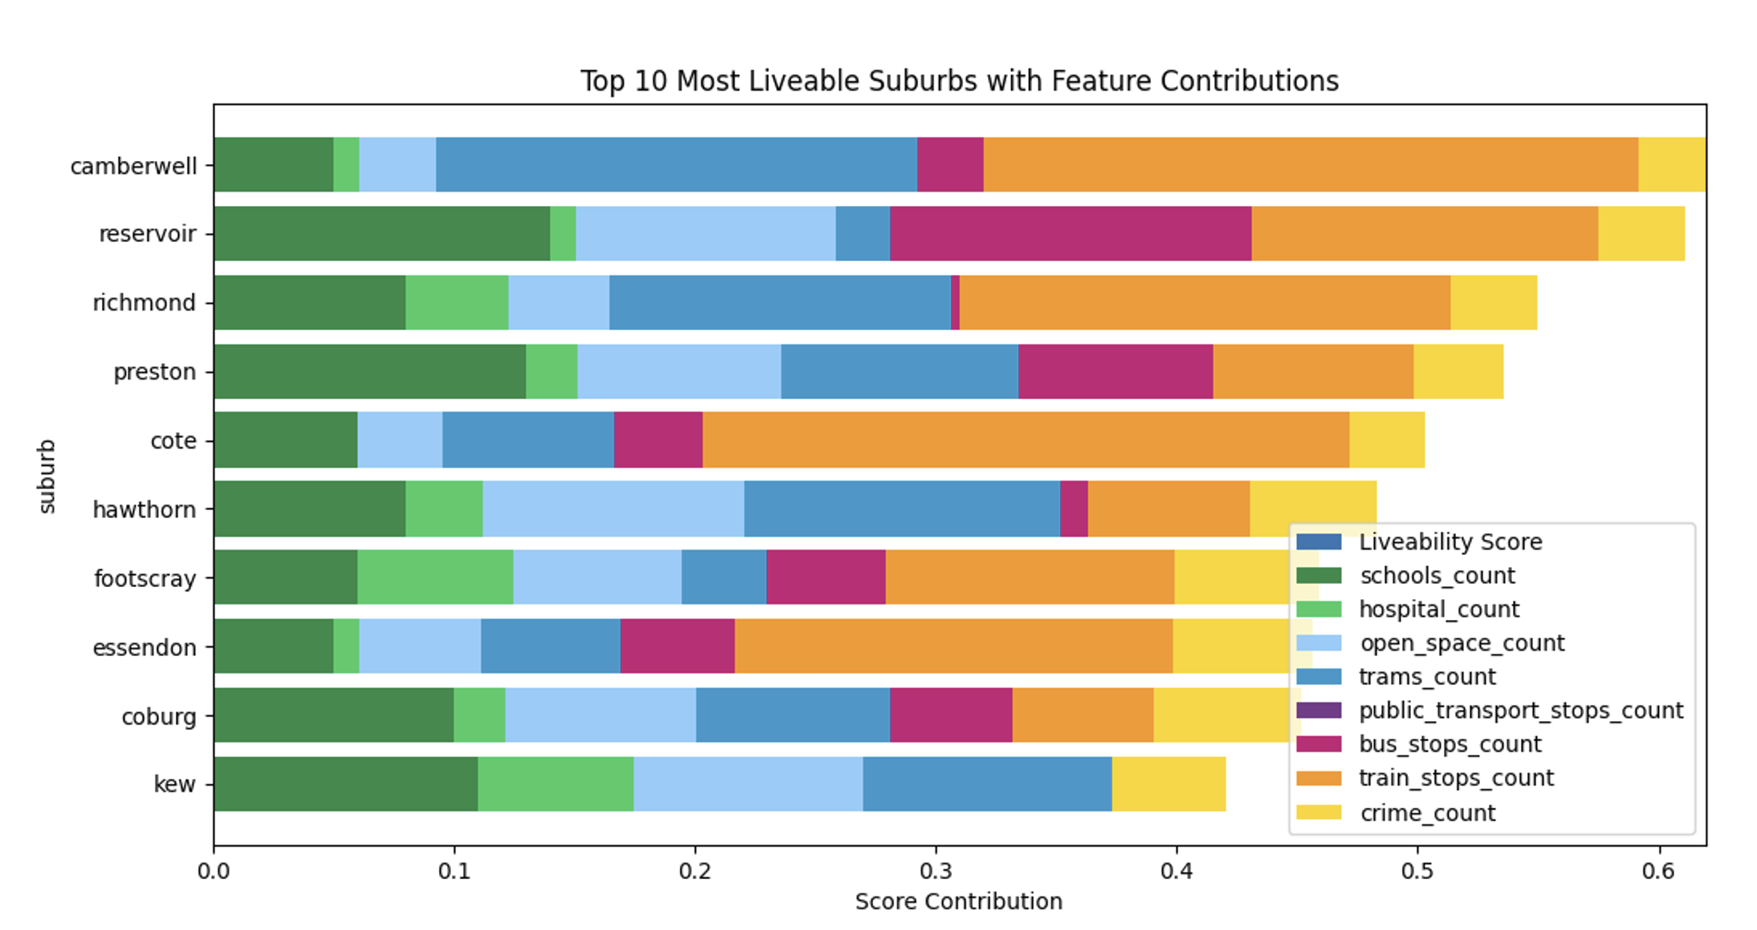
VICTORIA’S MOST LIVEABLE SUBURBS
Notes:
Camberwell has great connectivity, with train and tram stops contributing the most to it’s high liveability. Reservoir and Preston have lots of schools and open spaces, so are great places for families. All of the most liveable suburbs have low crime.

Slide 21
AFFORDABILITY
DEFINING AFFORDABILITY
‘The state of being cheap enough for people to be able to buy’
Cambridge Dictionary,2023,Affordability, https://dictionary.cambridge.org/dictionary/english/affordability
Notes:
Affordability must acknowledge income, and be relative to this.
Like the liveability calculation, the median rental price and median income were both standardised and given weightings.

Slide 22
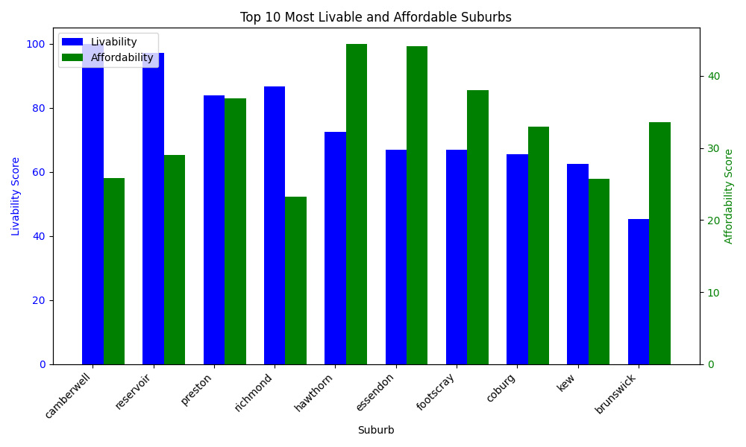
VICTORIA’S UNDERVALUED SUBURBS
Hawthorn, Essendon and Footscray are currently undervalued
Whilst being very liveable, renters will not tolerate further rental increases in Camberwell or Reservoir
Notes:
(Ingrid)

Slide 23

limitations and difficulties
Notes:
(Phoebe)

Slide 24


Data limitations
Limited knowledge of future infrastructure (Upcoming public transport plans are not published).
API quota (1000 rows per day).
Notes:
(30 sec)
- some features unable to be used because too much missing data
- Insufficient data and time to use more complex models
Time limitations: limited variables/datasets (finite exploration), model choice

Slide 25

FINAL RECOMMENDATIONS
Distance to CBD, Postcode, Income, and Bedrooms are significant factors in predicting rental price
Top 3 suburbs by growth:
House: Docklands, Nhill, Meeniyan
Apartment: Portland, Burwood, Box Hill
Townhouse: Elwood, Dandenong, Oakleigh South
(recommendation to invest in above suburbs based on customers/renter demographic)
Rental prices in Hawthorn, Essendon and Footscray should be revised and brought in line with current market conditions.
Camberwell and Reservoir rent should not be lifted, at risk of renters looking elsewhere.
Notes:
(50 sec)

Slide 26
FEASABILITY OF PROJECT
CURRENT VALUE PRODUCED
Insights
Understand determining factors of rental price
Suburbs rising in price and potential reasons
Most liveable and affordable suburbs
Quality of Model
Performing well (low error), despite simplicity of model
POTENTIAL VALUE FOR FUTURE EXPLORATION
Other Features
Consider other economic factors: expected future dwellings, expected net immigration, interests rates, gov. incentives
Granularity
Instead of using affordability based on average income, divide population into different categories by income, then determine affordability for each of these groups
Model Choice
DL Time series forecasting: Transformer-based models such as Autoformer, N-BEATS
Notes:
(Phoebe)
(40 sec)
Model choice:

Slide 27
THANK YOU!

